Slide 1


#Job Recommendation web Application…
Graduation project 2024
EELU : Fayoum Center
(JOB SHOP.)
Team Members:
-Mohamed Ehab Rabea Tawfik :2000245
-Mohamed Ahmed Mohamed Omran: 2001844
-Abdullah Ayman Rabea Morsi:2000192
-Youssef Ashraf Mohamed:2000235
-Romysaa Khaled Ramadan Gaballah:2000434
-Nada Karem Ahmed Mohamed:2000971
-Jumana Ahmed Mohamed : 2000991

Slide 2

-JOB SHOP
-Chapter1:Introduction.
-Chapter2:System Architecture.
-Chapter3:User Requirements.
-Chapter4:System Requirements.
-Chapter5:Design and Implementation.
-Chapter6: Testing.
-Chapter7: Conclusion.

Slide 3
Chapter 1:Introduction.
-Section 1.1-> problem definition & Background:
-Challenges and Pain Points:
-The traditional job search process is often overloaded and inefficient for both job seekers. Job seekers find it hard to find relevant job opportunities in a sea of listings, while employers face challenges in attracting qualified candidates.
Information Overload: Job seekers overloaded with a numerous job listings, making it difficult to find relevant opportunities.
Lack of Personalization: Existing job search platforms often lack personalization, resulting in mismatched job recommendations.
Inefficient Matching Process: Employers struggle to find qualified candidates, leading to prolonged hiring processes and increased costs.
-User Needs and Expectations:
Job Seekers: Expect personalized job recommendations tailored to their skills, experience, and career aspirations. They seek a user-friendly platform that simplifies the job search process.
Employers: Desire efficient candidate matching and recruitment processes. They expect access to a pool of qualified candidates that match their job requirements.

Slide 4
-To address the pain points:
we aim to develop a system that provides:
job seekers: with features :
Company administrator with features :
Has a profile that contains all of his information (Like CV), Job seeker can use these information as the default input to the recommendation engine or to apply on visible post enter the required info. Manually , this will speed up the input process , the recommendation response will be more relative to the job seeker qualifications.
Enter the main page(public) after login and the posts of the companies which related to his profile information will be displayed for him (can apply for the appropriate post with his profile information less or more).
Personalized job recommendations to job seekers based on their skills, experience, and preferences.
Job seeker (e.g. Student) can search with job title or related key words he want to know about the qualifications and skills required for this job.
For IT Students : can apply for posts of training and can get road map for specific IT skill
Any job seeker can request a recommendation service with only (his qualifications and skills).
-Any company Administrator (company , University , Courses Academy) can do :
Can make a company profile with all company information include definition of its fields each field contains default (required skills and qualifications),
Can create employers and give each employer one or many fields to make posts with these fields info(simplify posting process).
Can control all posts that already posted on the company profile page.
Any company employer with features :
Can make a post with his fields and additional skills.
Can make approval for matched applicants.

Slide 5
-Section 1.2-> Determining Goals :
Accurate Matching:
-The system accurately matches candidates with job openings based on their skills, qualifications , experience.
-This helps in providing relevant job recommendations to job seekers.
Personalization:
-Create a personalized experience for users by considering their unique skills, preferences, and career goals.
-A system that tailors recommendations to individual profiles increases the likelihood of a good fit between candidates and jobs.
Adaptability:
Build a system that can adapt to changes in the job market and technology landscape.
This includes staying up-to-date with the latest industry trends, emerging technologies, and in-demand skills.
Feedback Loop:
Implement a feedback mechanism that allows users to provide feedback on job recommendations.
This feedback loop helps in continuously improving the accuracy of the recommendations over time.

Slide 6
-Section 1.2-> Determining goals cont.
User Experience:
Prioritize a user-friendly interface that makes it easy for both employers and job seekers to interact with the system.
A positive user experience increases engagement and satisfaction.
Time Efficiency:
Help employers and job seekers save time in the hiring process.
By presenting relevant matches quickly, the system can simplify the recruitment process and reduce the time-to-hire.
Data Security and Privacy:
Implement robust security measures to protect the sensitive data of both employers and job seekers.
Privacy concerns should be addressed to build trust in the system.
Scalability:
Design the system to handle a large volume of users and job listings.
Scalability is essential to accommodate growth and ensure optimal performance as the user base expands.

Slide 7
-Section 1.3-> Scope:
Objectives:
Efficient Job Matching : The system aims to provide efficient and accurate job matching between job seekers and employers.
Enhanced User Experience: Focusing on creating an user-friendly experience for both job seekers and employers.
Personalization: The system will tailor recommendations based on user preferences, skills, and historical interactions.
Inclusions:
User Registration and Authentication: A secure registration and authentication process for job seekers and employers.
Profile Management: Ability for users to create and manage their profiles, including details such as skills, experience, and preferences.
Job Recommendation Engine: The functionality that leverages machine learning algorithms to match job seekers with relevant job opportunities.
Application and Recruitment Workflow : Support for job application processes and recruitment workflows for employers.
User Feedback Mechanism: Incorporating a feedback mechanism to gather user opinions and improve recommendations over time.
Exclusions:
Job Placement Services: The system may recommend jobs, but it does not handle the actual placement process or employment contracts. (It could be a future work).
Semantic analysis: Taking a CV from job seeker as a PDF file with semantics analysis (It will be a future work).
Background Checks :The system doesn't perform background checks on job seekers; it focuses on matching skills and preferences.

Slide 8
-Section 1.4-> Stakeholders:
1. Job Seekers:
Role: Individuals actively seeking employment.
Interests : Efficient job matching, personalized recommendations, user-friendly interface.
2. Employers/Recruiters:
Role: Entities responsible for hiring employees.
Interests : Access to a pool of qualified candidates, efficient recruitment processes, effective filtering mechanisms.
3. Company Administrators:
Role: Individuals responsible for company page maintenance, updates, and monitoring.
Interests : controlling of company page, update company fields, add ,update , delete (employers)
4. Developers and IT Team:
Role: Individuals responsible for the development and maintenance of system.
Interests : Efficient coding practices, system scalability, and reliability.

Slide 9
-Chapter 2: System Architecture.
Section2.1:System Components:
In this job recommendation system, several major components work together to provide users with personalized and relevant job suggestions :
1. Presentation Layer:
User Interface(UI):
The UI component is responsible for presenting information to users and capturing user input.
It includes the web-based interface for browsers.
User Interaction Module:
This module handles user actions, such as job searches, profile updates, and feedback submissions.
It communicates user requests to the business logic layer and displays the results to users.
2. Business Logic Layer:
Job Matching Module:
The core of the recommendation system, this module implements algorithms for matching job seekers with suitable job opportunities.
It considers factors such as user profiles, skills, preferences, and historical interactions.
User Management Module:
Manages user authentication, registration, and profile management.
Ensures secure and reliable access to user-specific data.
Recommendation Logic:
Implements business rules for generating job recommendations.
Takes input from the job matching module and refines recommendations based on user input.

Slide 10
-Section 2.1: System components cont.
2. Business Logic Layer: Cont.
Feedback Processing Module:
Gathers and processes user feedback on recommended jobs.
Incorporates feedback into the recommendation algorithms for continuous improvement.
Notification Module:
Sends notifications to users regarding new job recommendations, application status, or other relevant updates.
Enhances user engagement and keeps users informed.
3. Data Layer:
Database :
The primary data store that manages structured information, including user profile, job listings, historical data, and feedback.
Can be a relational database MySQL.
Data Access Objects (DAOs):
Components responsible for interacting with the database and abstracting the data access logic.
Retrieve and store data in response to requests from the business logic layer.
External Data Sources Integration: (Future Work..)
Interfaces with external data sources, such as industry trends or job market data, to supplement the system's knowledge.

Slide 11
-Section 2.1:System Components cont.
4.Communication Components:
**Ensuring seamless communication between these components is crucial for the overall functionality and performance of a job recommendation system, providing users with accurate and relevant job suggestions based on their preferences and qualifications.
RESTful APIs:
Facilitate communication between the presentation layer and the business logic layer using standard HTTP methods.
Allow for the exchange of information, including job search requests, feedback submissions, and recommendation responses.
Message Queues:
Enable asynchronous communication between components, allowing for background processing of tasks like updating recommendation algorithms or handling large datasets.
User Input Handler:
This component is responsible for receiving and processing user inputs from the UI. It translates user preferences, skills, experience, and other relevant information into a format that the recommendation engine can understand(for the recommendation page) and for the signup (creating profile with skills and other information needed for searching about job).

Slide 12
4.Communication Components cont. :
Recommendation Engine:
It uses algorithms and data analysis techniques to generate personalized job recommendations based on user input.
Communication with the user input handler is essential for receiving user preferences and providing relevant recommendations.
Data Storage and Retrieval:
This component stores and retrieves user profiles, job listings, and historical data. Effective communication between the system and the data storage/retrieval component is necessary for accessing and updating relevant information.
Notification Service:
communication with a notification service is necessary to inform users about (The acceptance for the application submitted for Job seeker, and the applications submitted for employer’s post).

Slide 13
-Section 2.2:Data flow
1. User Interaction:
Input:
Users interact with the system through the presentation layer, submitting requests, and providing input.
Input can include user registrations, profile updates, job searches, and feedback on recommended jobs.
2. User Interaction:
Responsibilities:
Receives user input and presents information to the user.
Translates user actions into requests processed by the business logic layer.
Data Flow:
Transmits user requests, queries, and feedback to the business logic layer.
3. Business Logic Layer:
Responsibilities:
Processes user requests, executes business rules, and orchestrates the flow of data.
Coordinates interactions between the presentation layer and the data layer.
Data Flow:
Communicates with the data layer to retrieve user profiles, job listings, and other relevant data.
Utilizes algorithms to generate personalized job recommendations based on user profiles and preferences.
Processes user feedback to refine the recommendation algorithms over time.
Sends job recommendations and other relevant information back to the presentation layer.

Slide 14
-Section 2.2:Data flow Cont.
4. Data Layer:
Responsibilities:
Manages the storage and retrieval of data used by the system.
Stores user profiles, job listings, historical data, and other relevant information.
Data flow:
Stores and retrieves user profiles, including skills, experience, and preferences.
Manages job listings, storing information about available positions, company details, and job requirements.
Records user feedback and engagement data for analysis.
5. Job Matching and Recommendation:
Responsibilities:
The job matching module within the business logic layer generates personalized job recommendations.
Utilizes recommendation algorithms that consider user profiles , preferences , and historical interactions.
Data Flow:
Processes user profiles and job listings to determine suitable matches.
Generates a list of recommended jobs based on the matching criteria.
Sends the list of recommended jobs back to the presentation layer for display to the user.

Slide 15
-Section 2.2:Data flow Cont.
6. User Feedback Processing:
Responsibilities:
Collects and processes feedback provided by users on recommended jobs.
Incorporates feedback into the recommendation algorithms to improve future suggestions.
Data Flow:
Gathers feedback data from users, including likes, dislikes, and application outcomes.
Analyzes feedback to identify patterns and trends.
Updates recommendation algorithms based on the analysis.

Slide 16
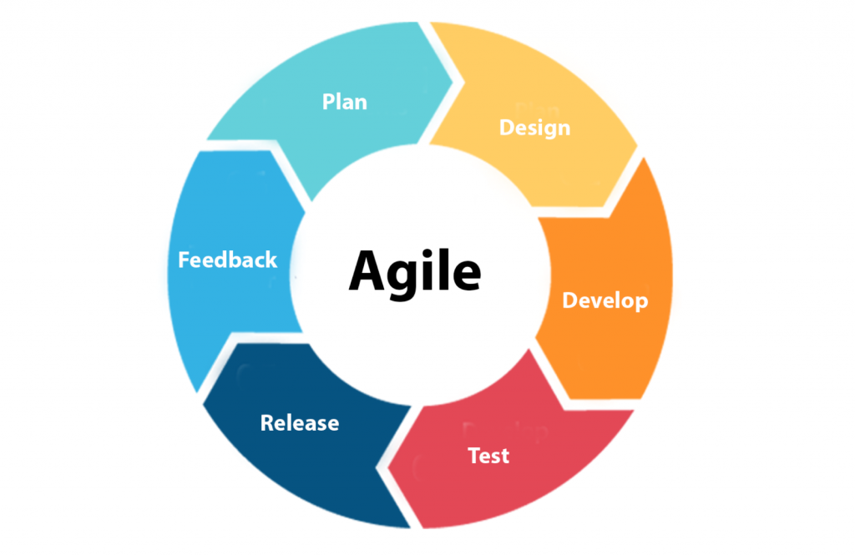
-Section 2.3:Methodology
We will Use the Agile Model to Apply Job Recommendation System.
Agile is well-suited for projects with evolving requirements, where feedback and adaptability are crucial.
The iterative nature of Agile development can accommodate the dynamic nature of job recommendation systems, allowing for continuous refinement based on user feedback and changing market demands.
We Can identify the important additional requirements and add them to subsequent versions.

Slide 17
-Chapter 3 :User Requirements:
Section3.1-Job Seekers:
1.Login(functional).
2.User Profiles(functional).
3.Job Search(functional).
4.Recommendations(functional).
5.Security(Non functional).
6. Application submission(functional).
7.Applications management(functional).
Section3.2-Employers:
1.Login(functional).
2.Job Posting(functional).
3.Candidate Matching(functional).
4.Submitted applications Management(functional).
5.Security(Non functional).
6.Analytics(functional).

Slide 18
Section3.3-Company Administrators:
1.Employer Management(functional).
2.Content Management(functional).
3.Field Management(functional).
4.Analytics and Reporting(functional).
5.Job posting( functional ).
Section 3.4:Use Cases Detailed Descriptions
Use case Number: | 01
Use case Name: | User Registration and Profile Creation
Overview: | User register to the site.
Actor(s): | Job Seeker , Administrator.
Pre-condition(s) | User connected to the internet
Scenario flow : | Open website. Click Registration . Enter his user name & password and necessary information. Display registered successfully.
Alternate flow : | 4a- If the user name or password not meet the terms the website will display Error message and go to step 3.
Post Condition: | they can create and manage their profiles, including details such as education, work experience, skills, and preferences.

Slide 19
Use case Number: | 02
Use case Name: | User Authentication
Overview: | User Login to the site.
Actor(s): | Job Seeker ,Employer and Administrator.
Pre-condition(s) | User connected to the internet and Registered .
Scenario flow : | Open website. Click Login. Enter his user name & password. Display login successfully .
Alternate flow : | 4a- If the user name or password not correct the website will display Error message and go to step 3.
Post Condition: | The system will display home page.
Use case Number: | 03
Use case Name: | Job Search and Filtering
Overview: | search for IT jobs using various filters such as keywords, location, skills, experience level, and job type.
Actor(s): | Job Seeker
Pre-condition(s) | User connected to the internet and Logged in.
Scenario flow : | Login to website. Click search for a job with job title. Enter keywords, skills, experience ,and job type. Display List of relevant jobs.
Alternate flow : | 4a- If there is no job matching the user's qualifications, the system can nominate some requirements for the closest job.
Post Condition: | The system return relevant job listings based on the search criteria.

Slide 20
Use case Number: | 04
Use case Name: | Job Posting
Overview: | post IT job openings by providing detailed job descriptions.
Actor(s): | Company Administrator , Employers
Pre-condition(s) | Employers connected to the internet and Logged in.
Scenario flow : | Login to website. Click make a post. Enter detailed job descriptions , Fields contains (required skills, qualifications) and other relevant information. Display the posted jobs on the main page and on the company profile page.
Alternate flow : | ________________
Post Condition: | The posted jobs should become visible to job seekers.
Use case Number: | 05
Use case Name: | Application Submission
Overview: | apply for jobs by submitting their applications through the system.
Actor(s): | Job Seeker
Pre-condition(s) | Users connected to the internet and Logged in.
Scenario flow : | Login to website. Scroll the main page that contains many employers posts for many jobs. Apply for jobs by submitting their applications through the system. If there is matching between the applicant’s qualification and the requirements of the job posted , the system will notify both of applicant and employers.
Alternate flow : | 4.a If there is no matching between them the system will display some of Qualifications that the applicant lacks for the applicant and some resources for these qual.
Post Condition: | The application process may involve uploading resumes, cover letters, and other relevant documents.

Slide 21
Use case Number: | 06
Use case Name: | Application Management
Overview: | Both job seekers and employers should have tools to manage job applications. Job seekers can track the status of their applications.
Actor(s): | Company Administrator , Job Seeker, Employer
Pre-condition(s) | Users connected to the internet and Logged in.
Scenario flow : | Login to website. Click manage applications.
Alternate flow : | _______________
Post Condition: | The system display list of Applications are on request for Job seekers , and display list of requests for Employers
Use case Number: | 07
Use case Name: | Employers management and Reporting.
Overview: | Administrators should have access to analytics and reporting features.
Actor(s): | Company Administrator
Pre-condition(s) | Users connected to the internet and Logged in.
Scenario flow : | Login to website. Click Analytics and Reporting. Manage Employers accounts & generate reports.
Alternate flow : | _______________
Post Condition: | The system generate reports for job posting performance, and other relevant statistics.

Slide 22
Use case Number: | 08
Use case Name: | Fields Management.
Overview: | Create , update and delete fields (each field contains skills) that the company support.
Actor(s): | Company Administrator
Pre-condition(s) | Administrator connected to the internet and Logged in.
Scenario flow : | Login to website. Click On manage fields. Selection of Add or delete or update fields. Enter the required data.
Alternate flow : | _______________
Post Condition: | Company’s fields must be added to the database via administrator only.
Use case Number: | 09
Use case Name: | Feedback
Overview: | Getting feedback from users for improvement.
Actor(s): | Job Seeker, Employer
Pre-condition(s) | Users connected to the internet and Logged in.
Scenario flow : | Login to website. Click On feedback. Enter their opinion about using the system
Alternate flow : | _______________
Post Condition: | Users should be able to provide feedback on the job recommendations.

Slide 23
Use case Number: | 10
Use case Name: | Recommendation request
Overview: | Job seeker can user recommendation for getting related posts based on his qualifications and skills.
Actor(s): | Job Seeker
Pre-condition(s) | Users connected to the internet and Logged in.
Scenario flow : | Login to website. Click On recommend me. Select from list the request type (Titled(in site(Both,Opened,closed), predefined), Not titled(in site(Both, Opened,Closed), predefined (already closed))). Enter qualifications and skills based on his selection. Click submit.
Alternate flow : | 5-a if the validation of his input failed , system will display error message and request from user to complete true input
Post Condition: | The system generate responses based on job seeker input

Slide 24
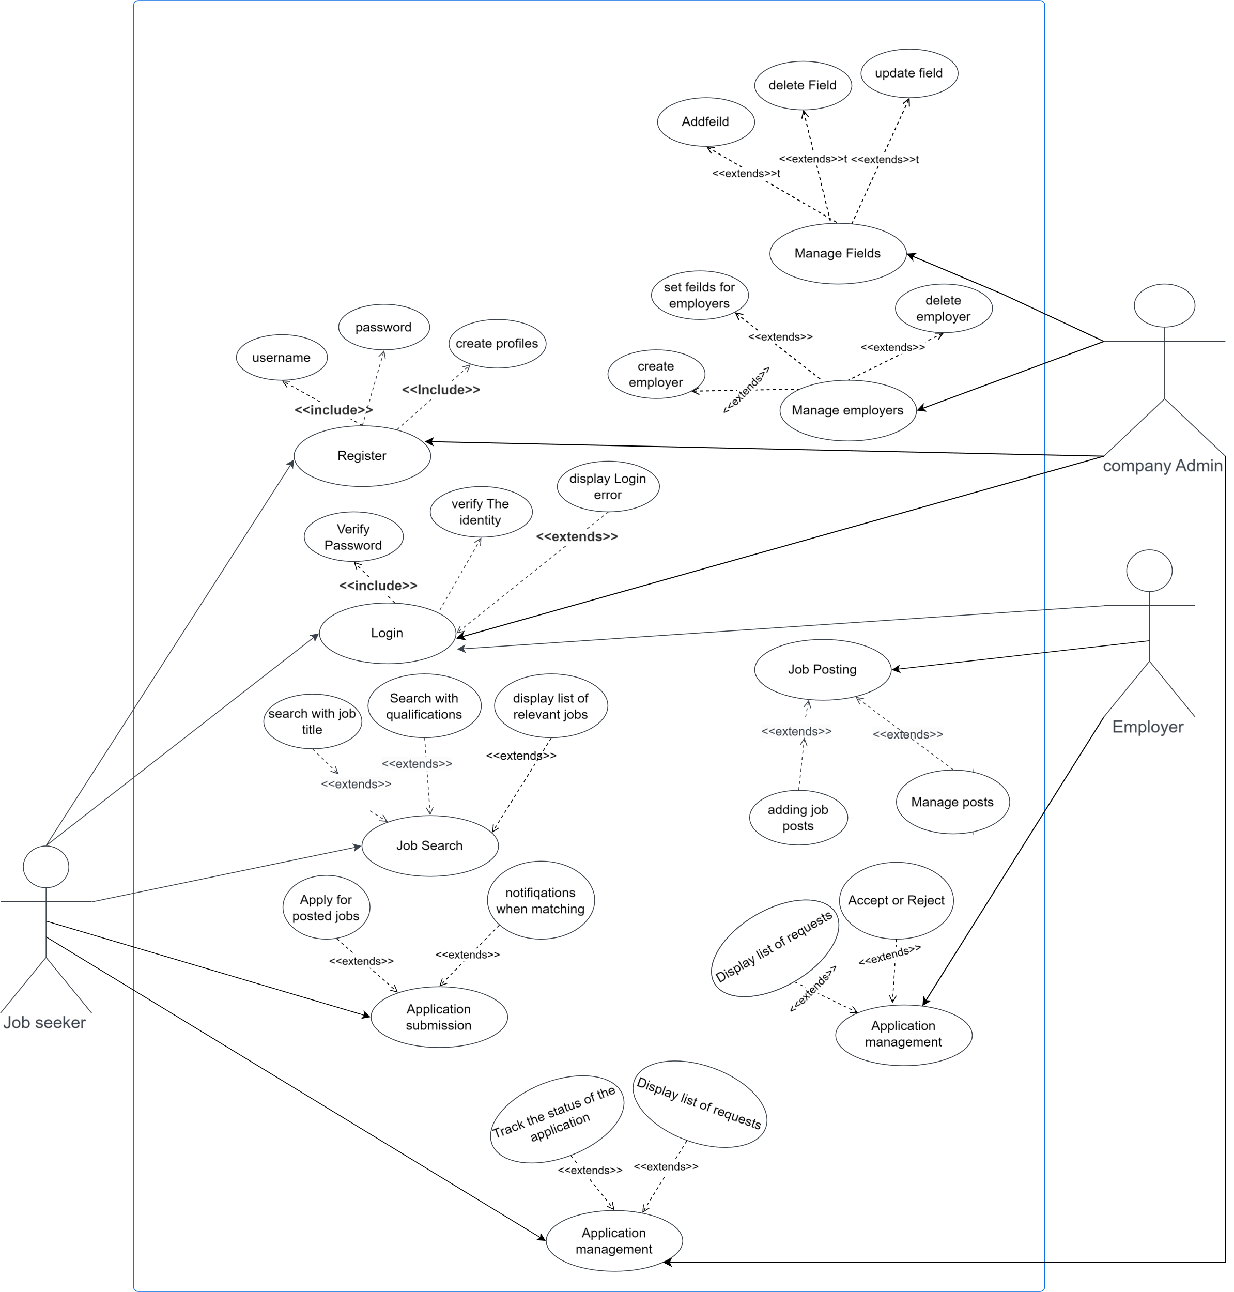
-Section3.5: UML Use case Diagram.

Slide 25
-Chapter 4: System Requirements.
Section4.1:Functional Requirements: (What the system should do)
1.User Authentication and Authorization:
-Users should be able to create accounts and log in securely.
-Different roles (job seekers, employers, administrators) should have specific permissions and access levels.
2.User Profiles:
-Users should be able to create and manage comprehensive profiles.
-Profiles should include information such as education, work experience, skills, certifications, and preferences.
3.Job Search and Filters:
- Job seekers should be able to search for IT jobs based on keywords, location, skills, experience level, and other relevant filters.
4.Job Recommendation:
-The system should provide personalized job recommendations based on the user's profile, skills, and preferences.
5.Job Posting:
- Employers should be able to post IT job openings, including detailed job descriptions, required skills, and qualifications.
6.Candidate Matching:
-Tools to match job openings with suitable candidates based on skills, experience, and qualifications.
7.Application Management:
- Job seekers should have tools to track and manage job applications, including status updates and notifications.
- Employers should be able to efficiently manage and track applications received.

Slide 26
-Section 4.1 :Functional Cont.
8.Communication Features:
- Users (job seekers and employers) should be able to communicate within the system, facilitating interaction during the hiring process.
9.Analytics and Reporting:
- Administrators and employers should have access to analytics and reporting features to monitor system performance, user engagement, and job posting effectiveness.
10.Feedback Mechanism:
- The system should include a feedback mechanism for users to provide feedback on job recommendations, application processes, and overall user experience.
***These functional requirements : Describe the specific functionalities and features that the system must provide to meet the needs of its users.

Slide 27
-Section 4.2:Non-Functional Requirements: (How well the system should perform.)
1.Scalability:
-The system should be scalable to handle a growing number of users, job listings, and interactions.
2.Performance:
-The system should be optimized for performance to ensure quick response times for users.
3.Security:
- Data should be encrypted during transmission (using SSL/TLS).
- Secure storage and access controls should be implemented to protect user data.
- Regular security audits should be conducted.
4.Reliability:
- The system should have high reliability, minimizing downtime and ensuring continuous availability.
5.Compatibility :
-The system should be compatible with various devices and browsers to ensure a seamless user experience.
6.Maintainability:
-The system should be designed with maintainability in mind, allowing for easy updates, bug fixes, and improvements.
7.Usability:
-The user interface should be user-friendly, catering to users with varying levels of technical expertise.

Slide 28
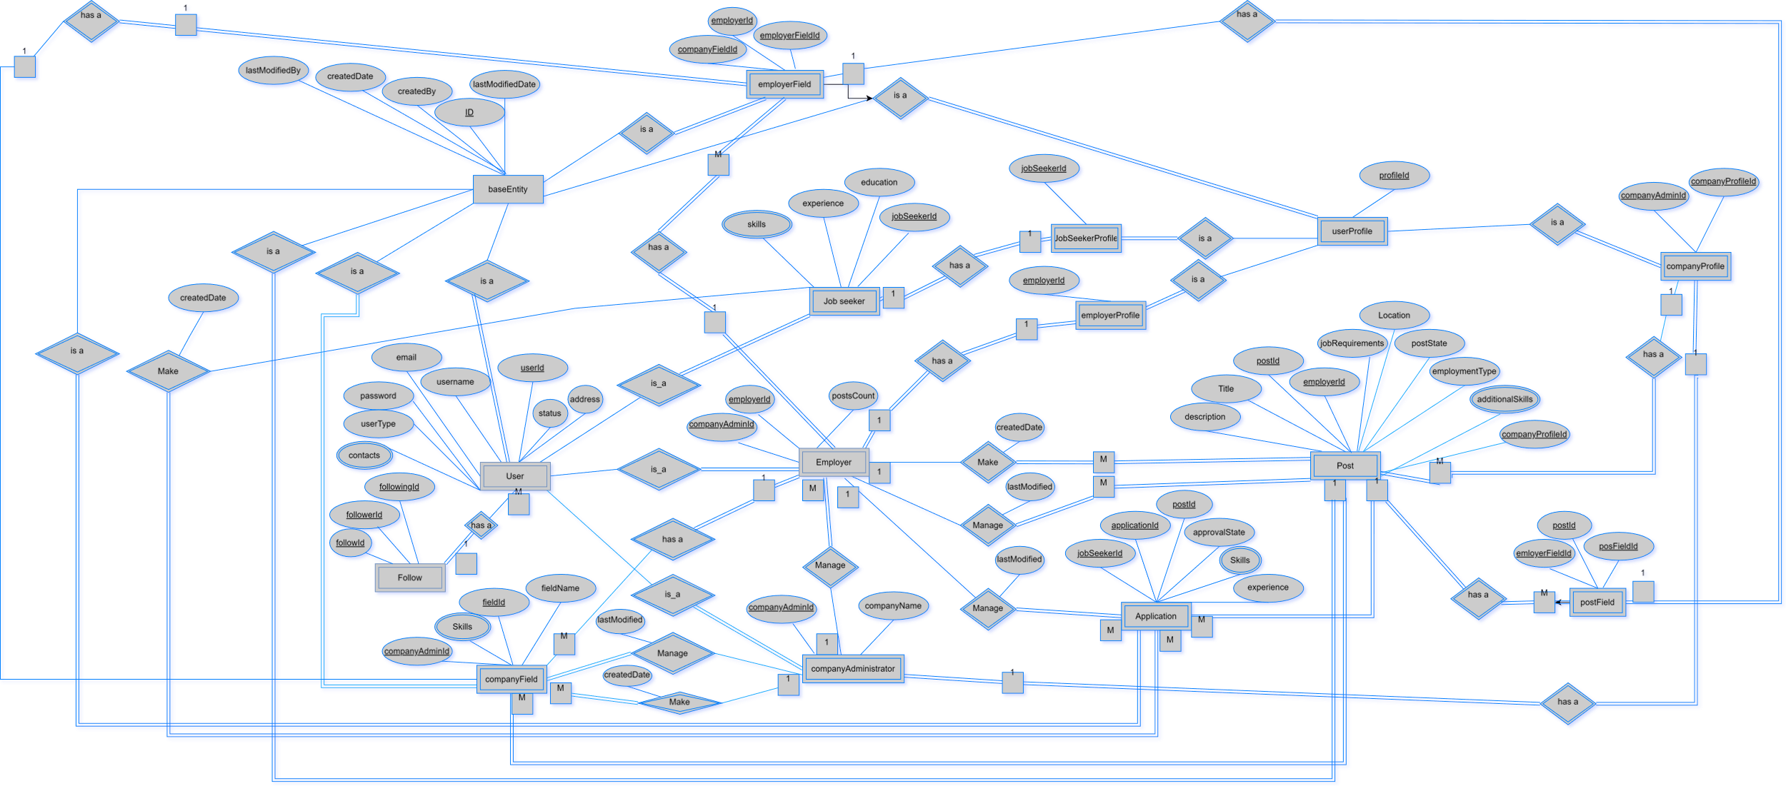
-Chapter 6: Design and Implementation.
Graduation Project 2024
-Section 5.1.1:Entity Relationship Diagram(ERD)

Slide 29
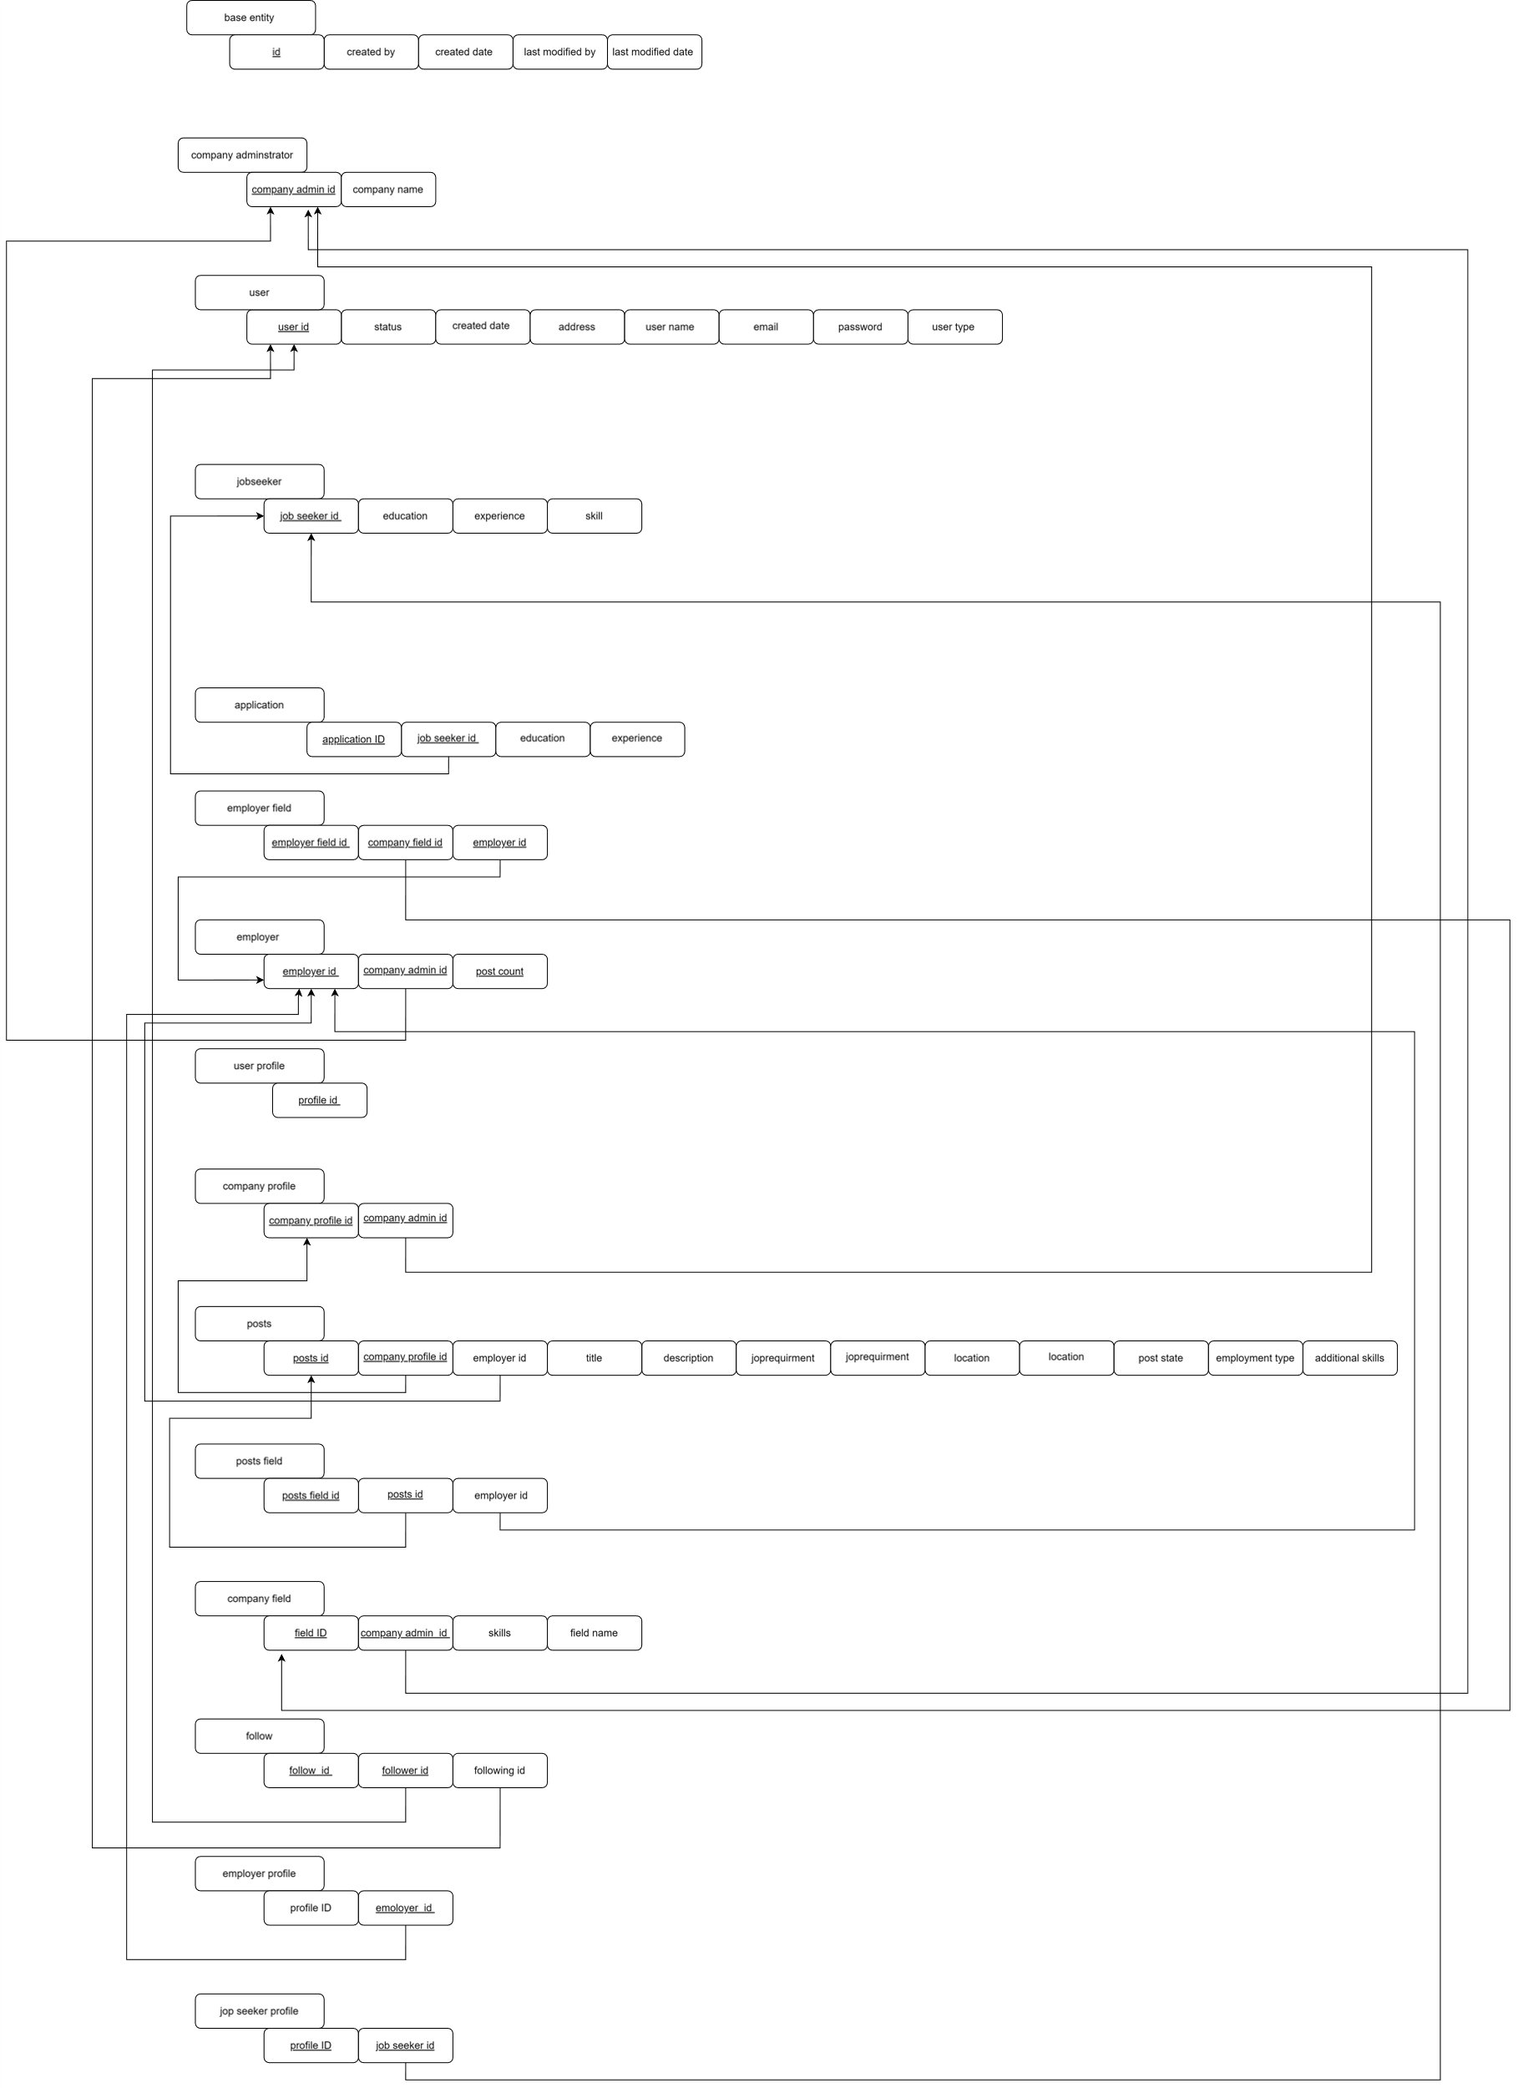
-Section 5.1.2:Rational Schema

Slide 30
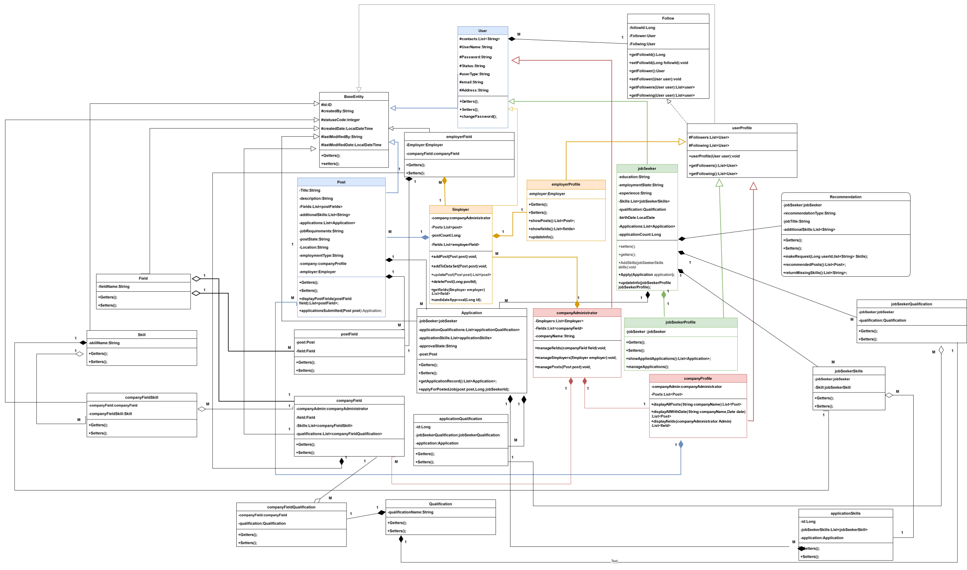
-Section 5.2:UML Class Diagram:

Slide 31
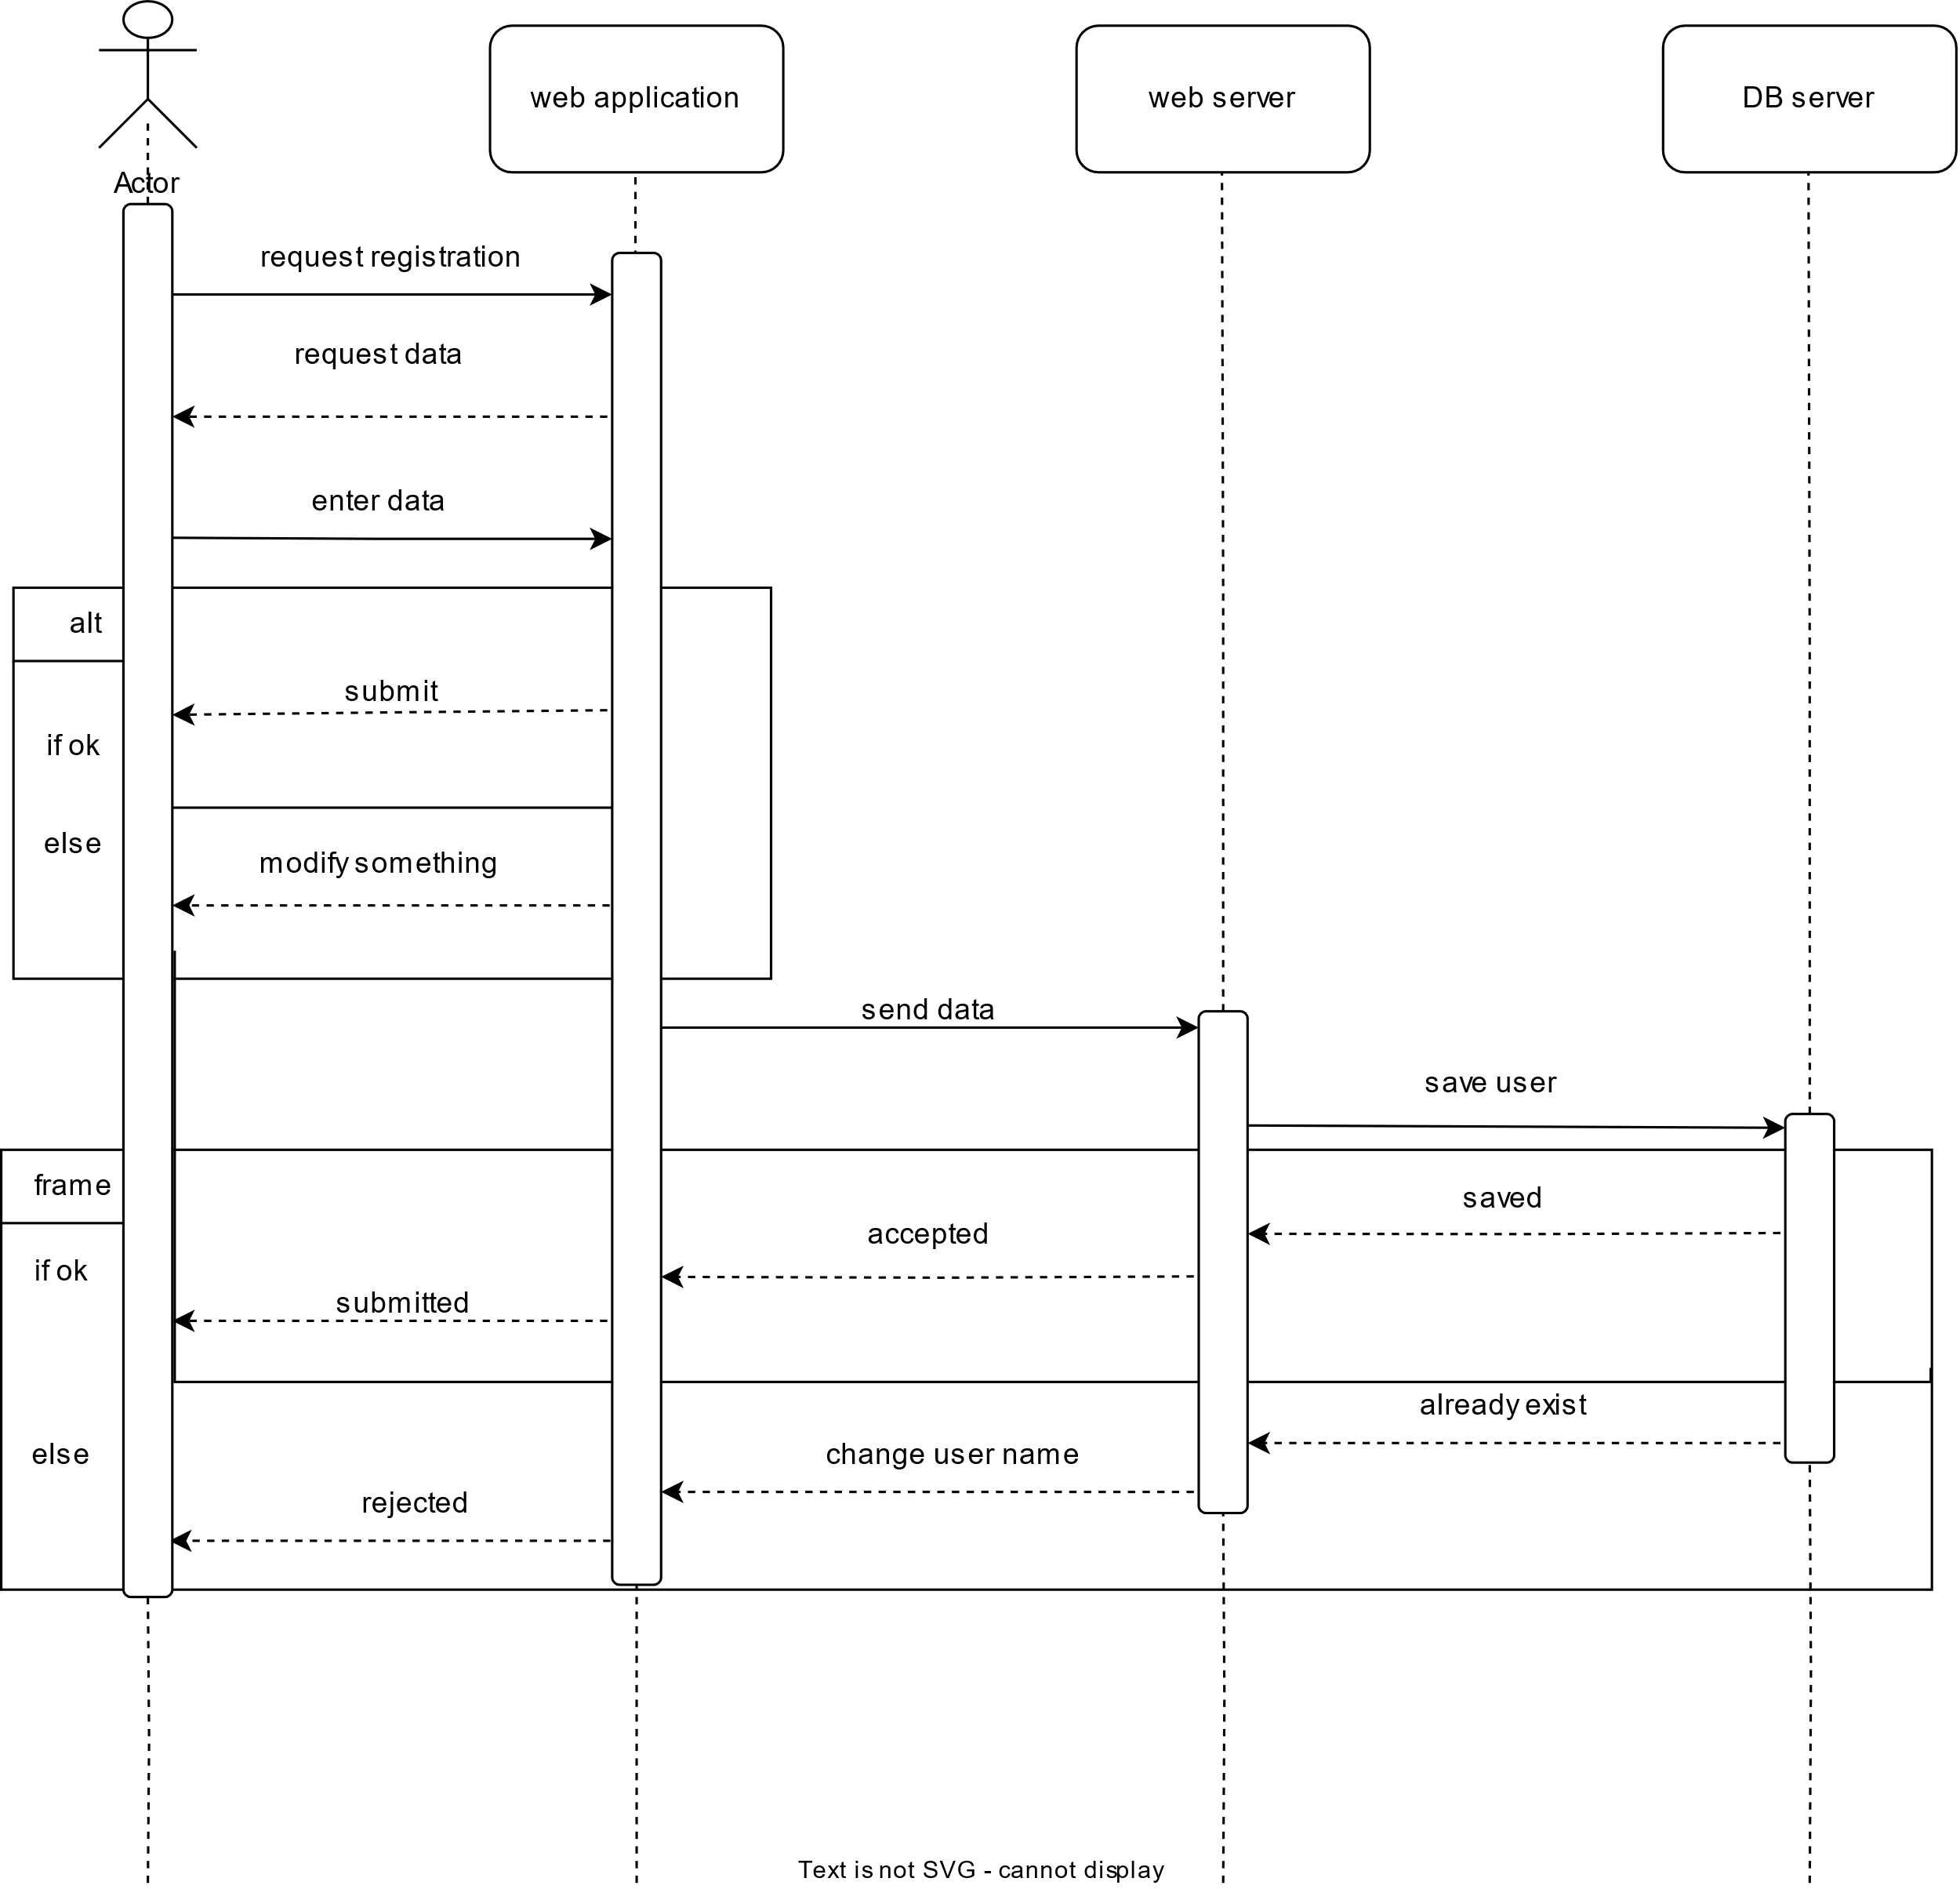
-Section 6.3:Sequence Diagram:
Section 5.3.1:Regiteration

Slide 32
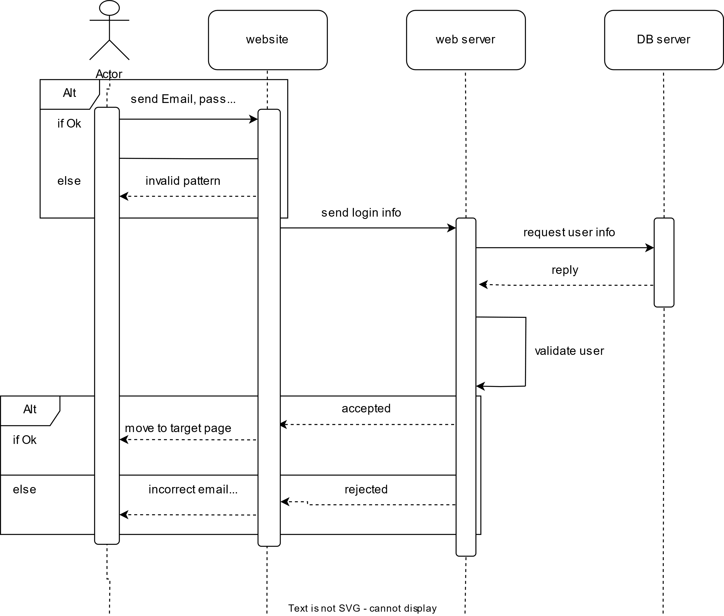
Section 5.3.2:LOGIN

Slide 33
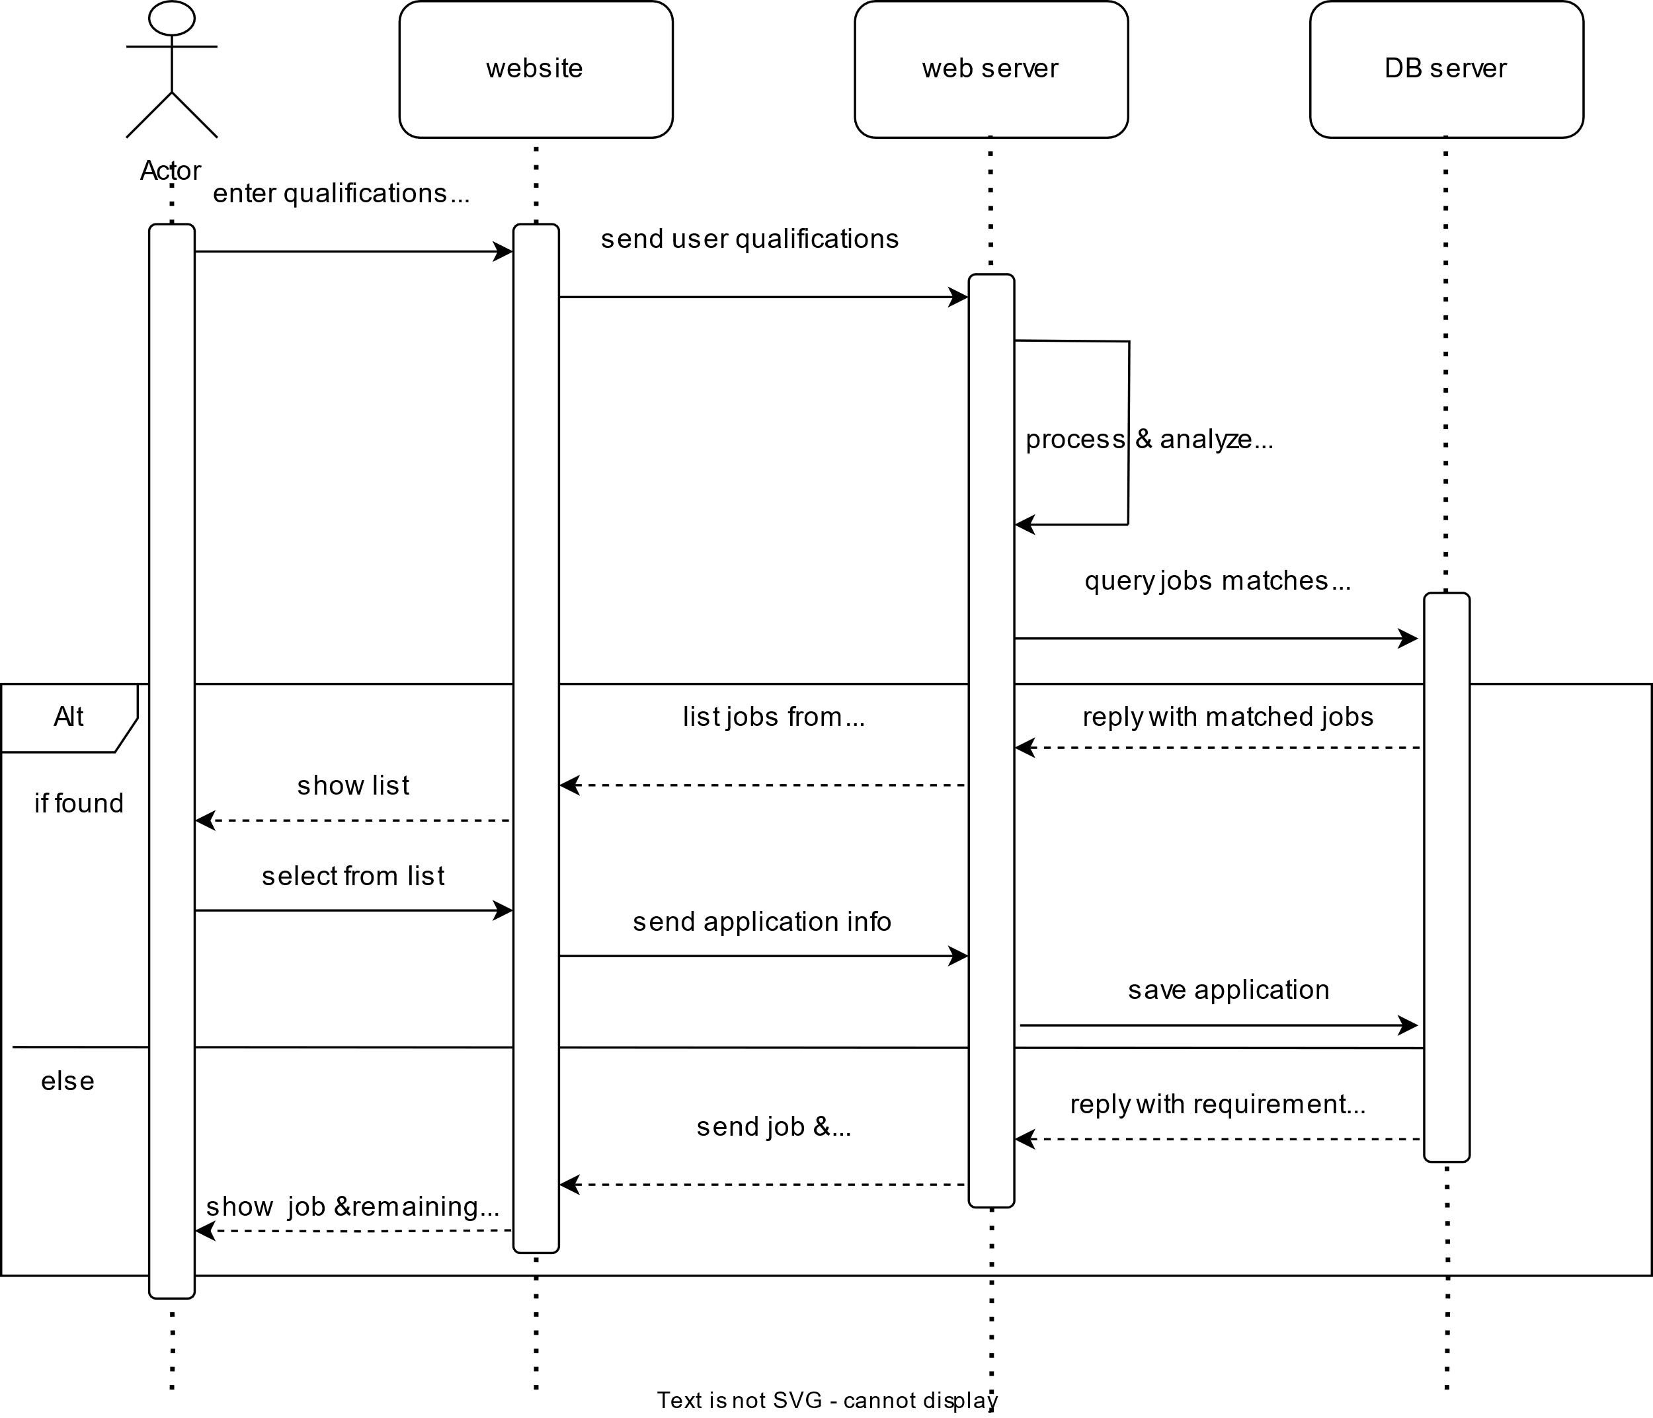
-Section 5.3.3: Job Search

Slide 34
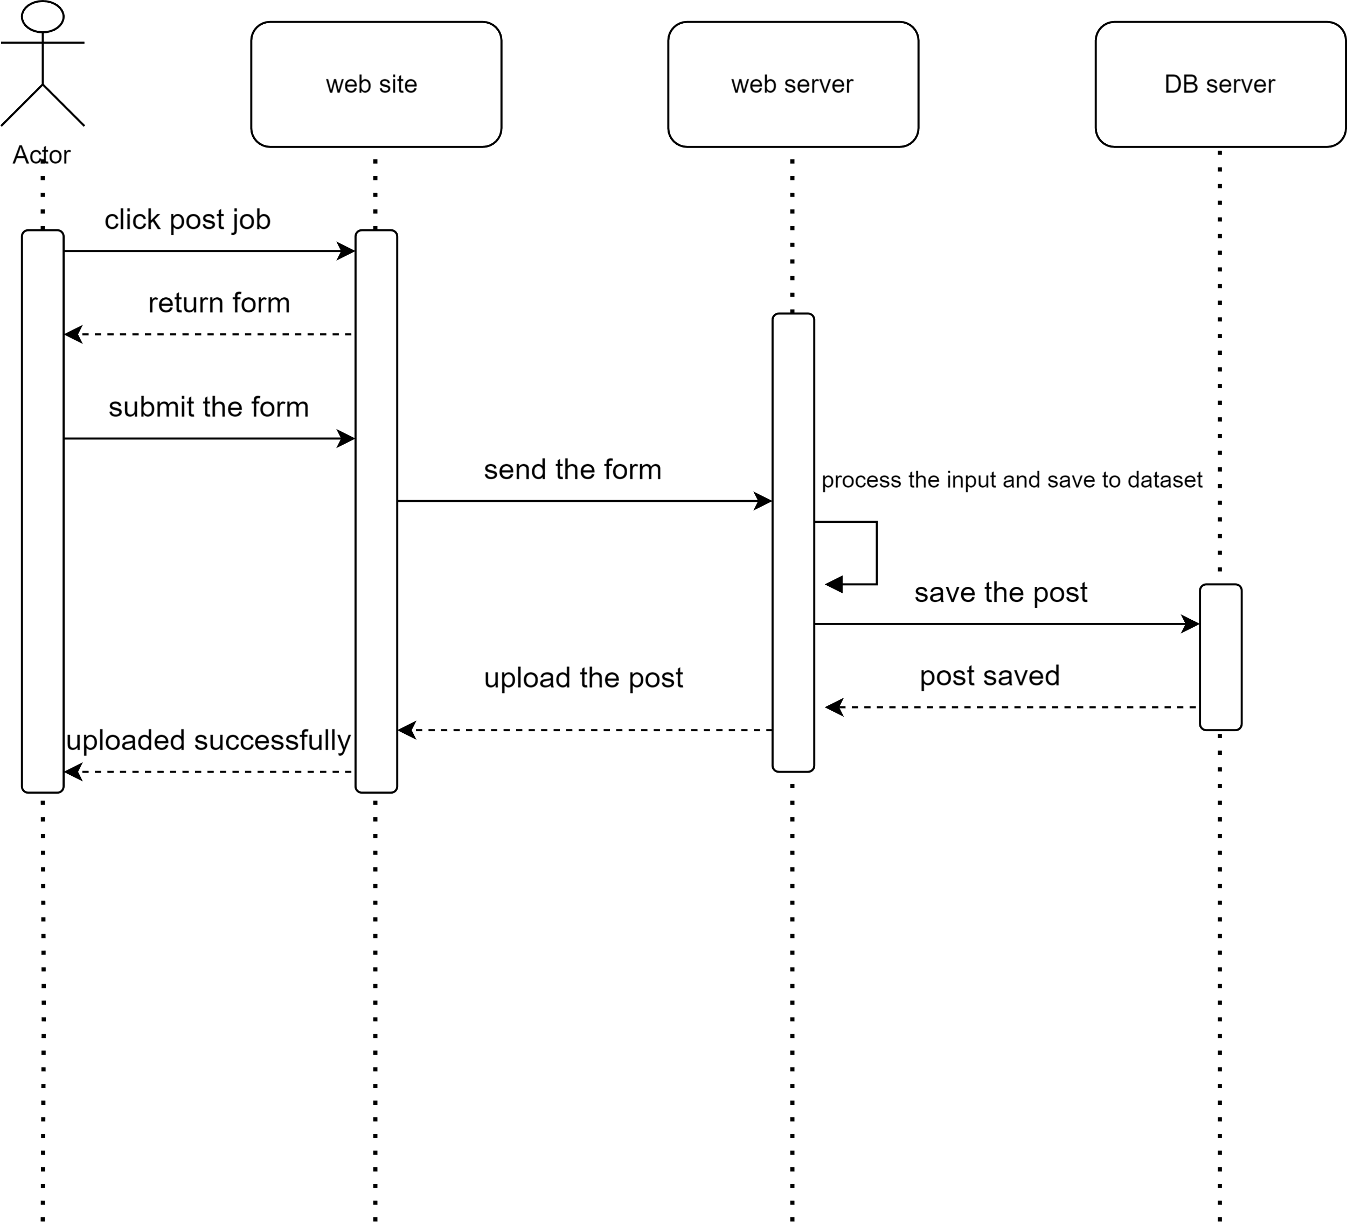
-Section 5.3.4: Make a post

Slide 35
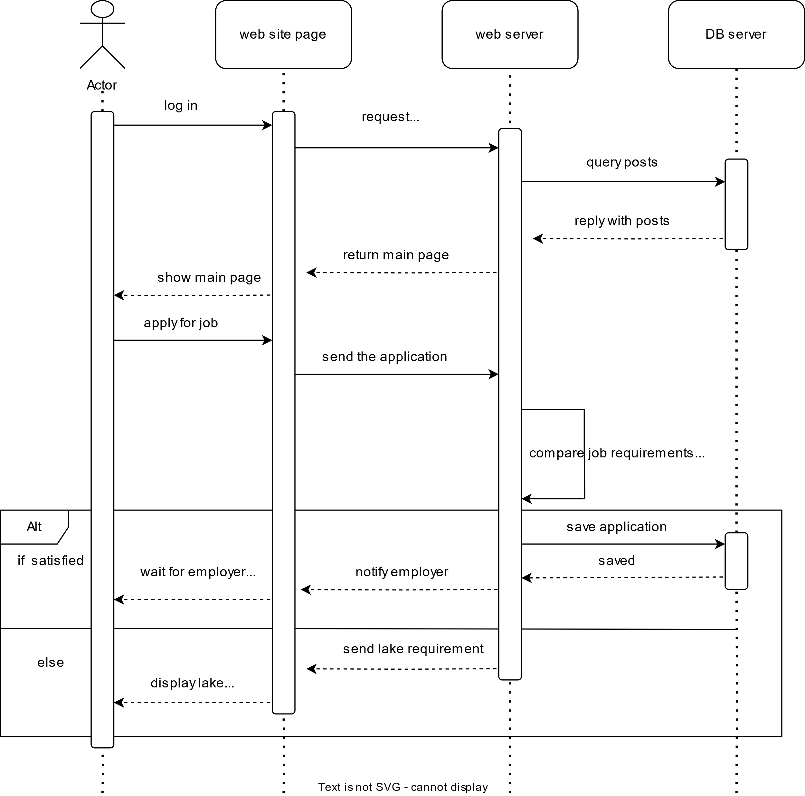
-Section 5.3.5:Application submission

Slide 36
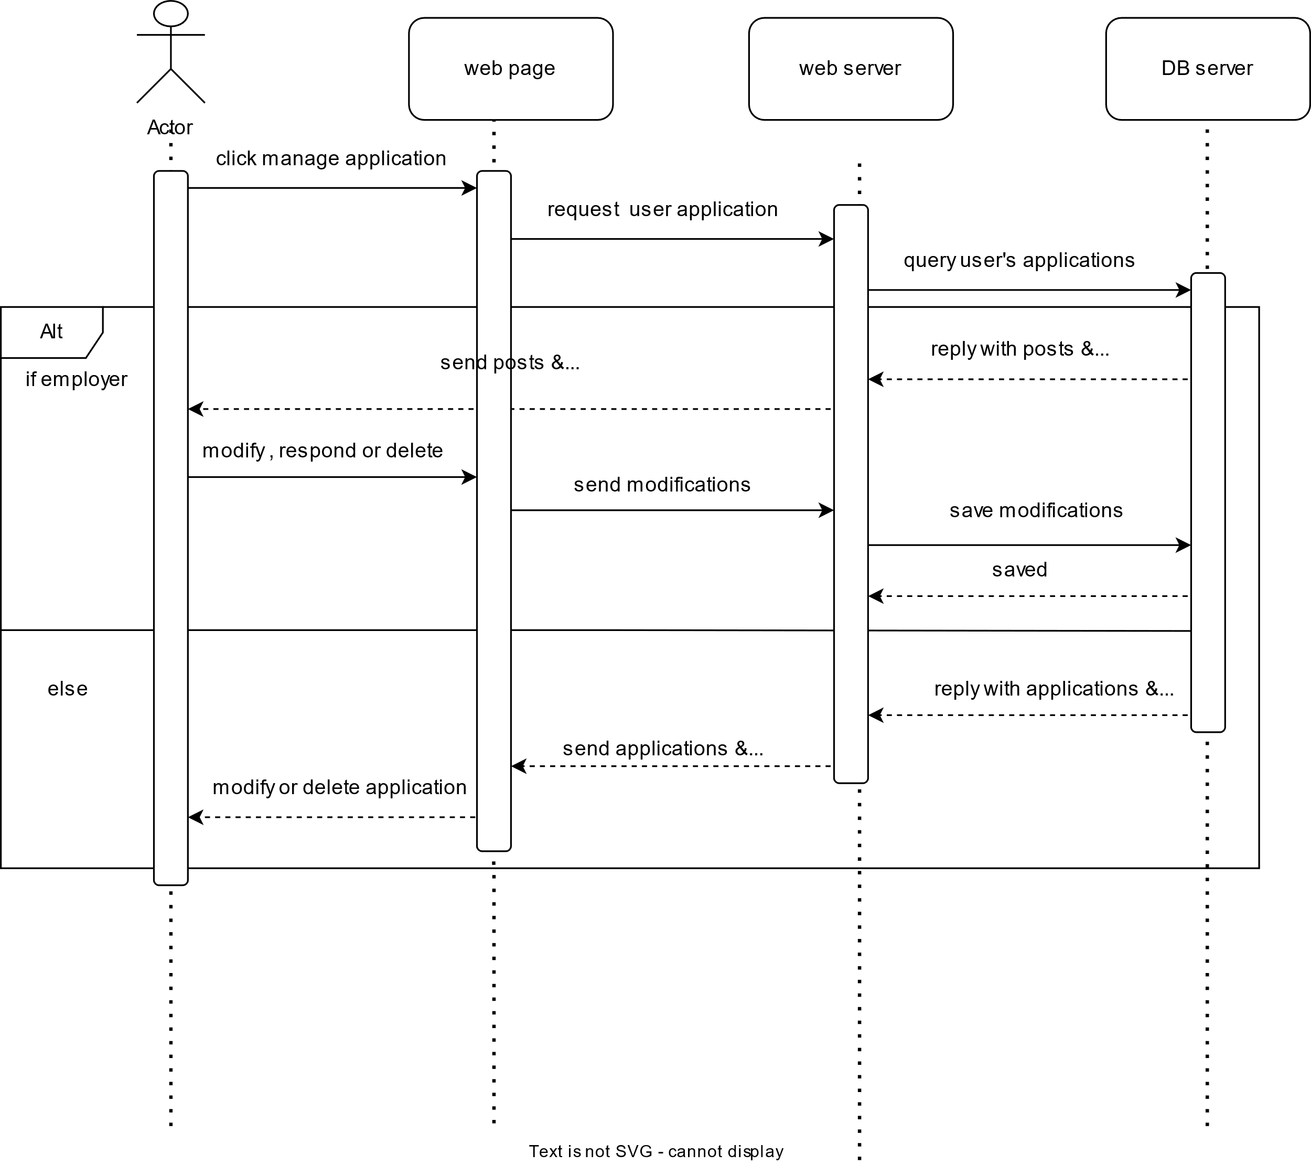
-Section 5.3.6 :Application Management

Slide 37
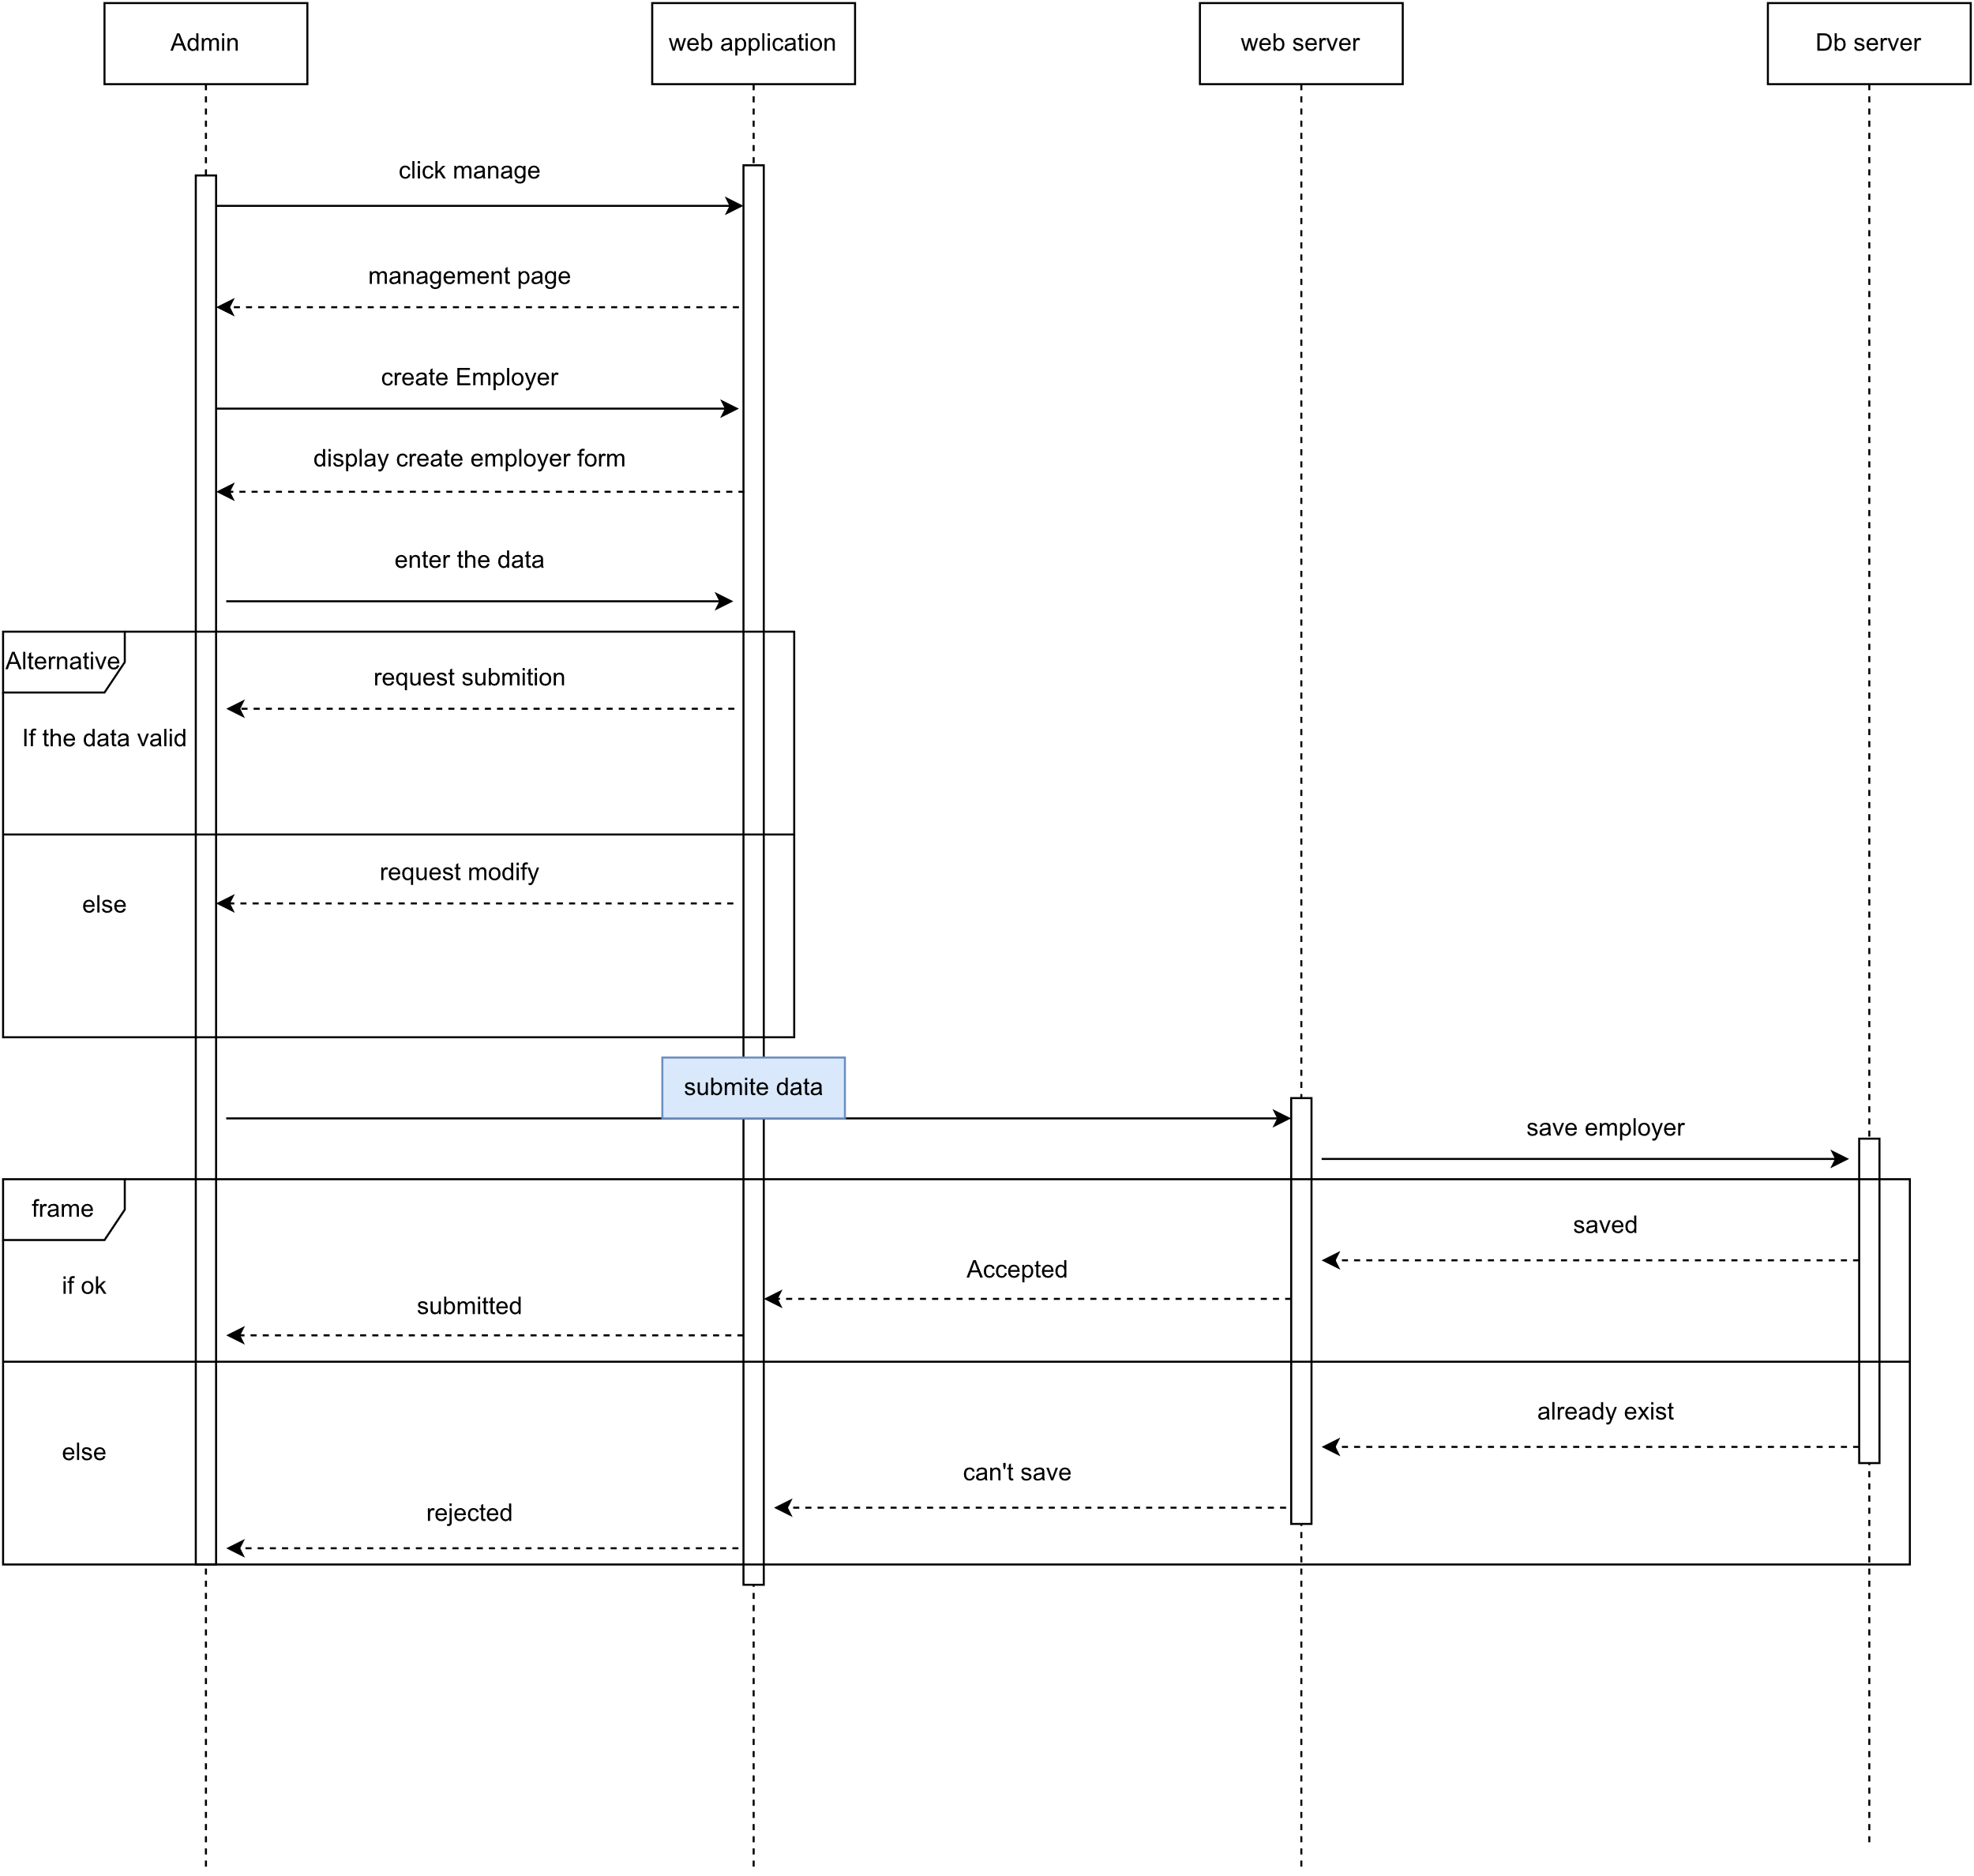
-Section 5.3.7:Create Employer.

Slide 38
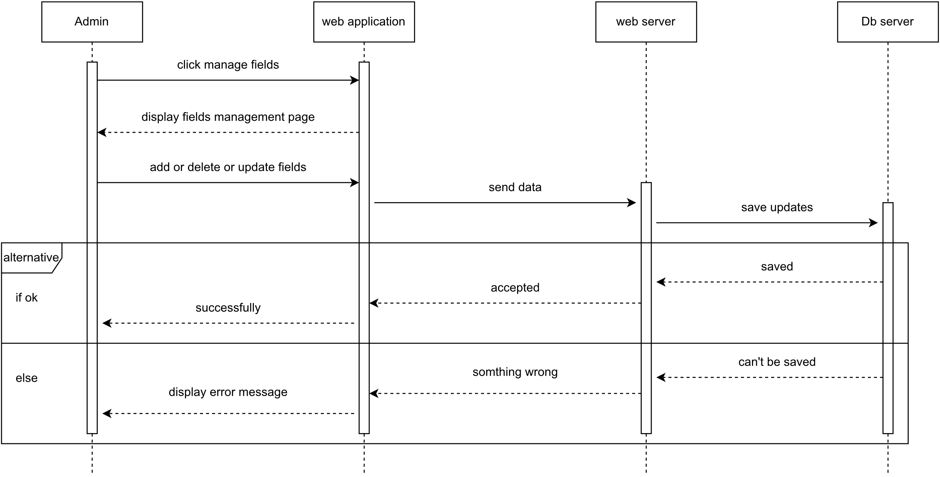
-Section 5.3.8: fields Management

Slide 39
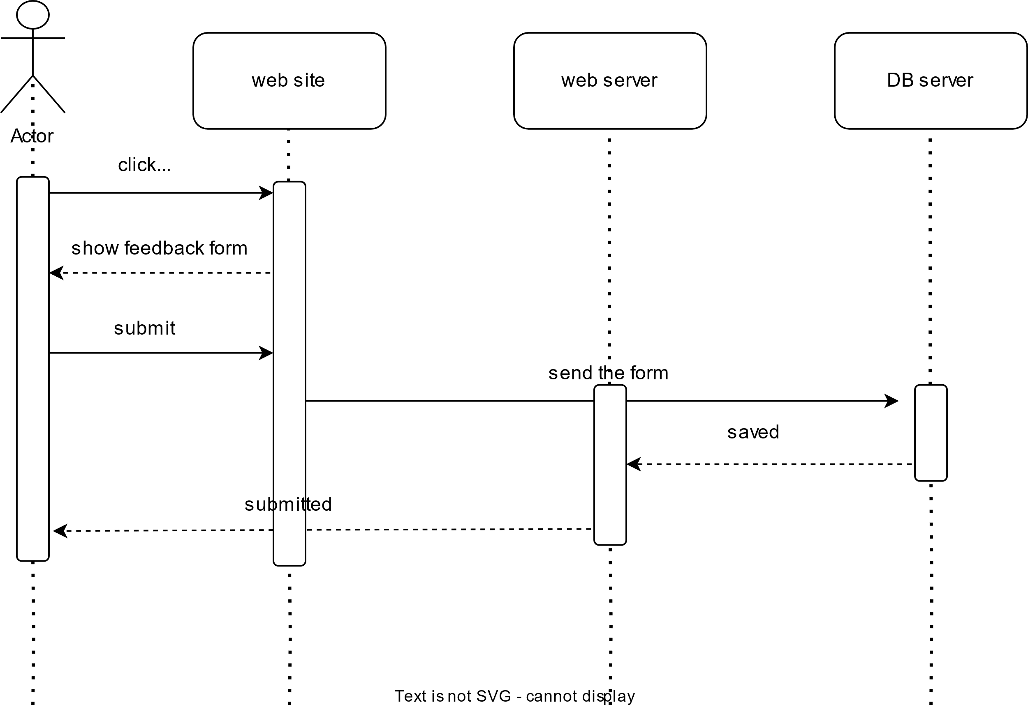
-Section 5.3.9: Feedback

Slide 40
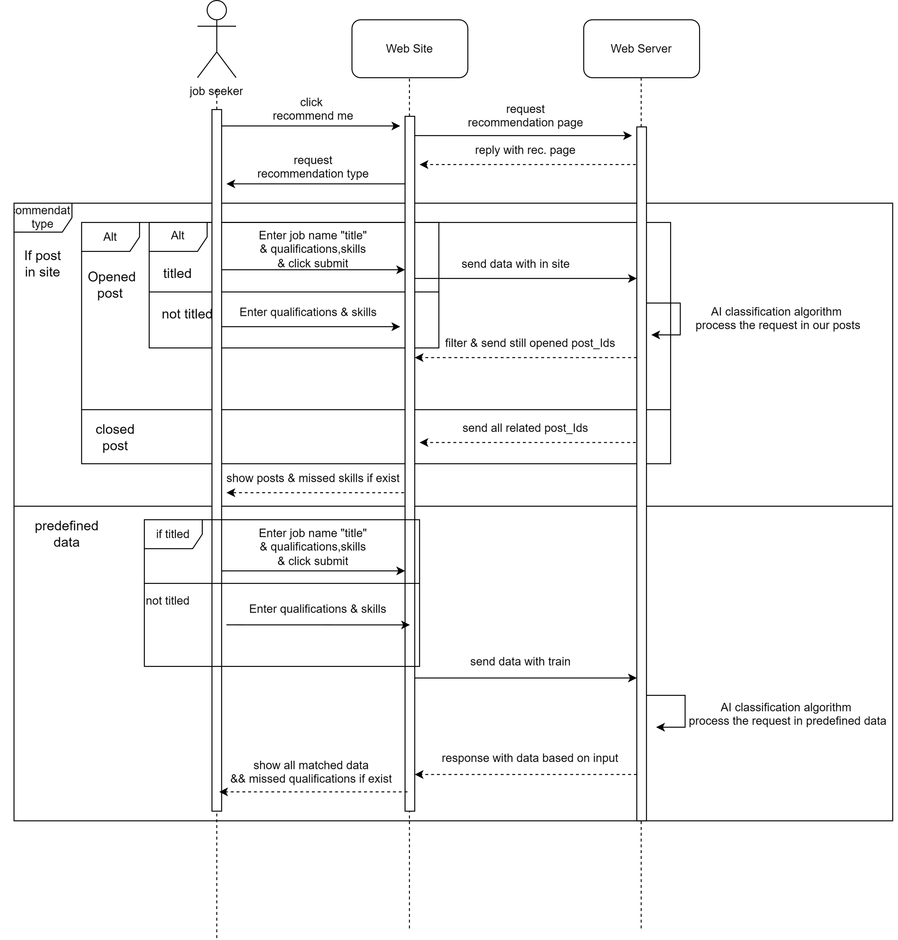
-Section 5.3.10:
Request recommendation.

Slide 41
-Section 5.4: Implementation
-> 5.4.1 Implementation Environment :
-Programming Language used is (JAVA) ,it’s advantages:
Object Oriented
Platform Independent
Simple
Secure
Portable
Robust
Multithreaded
Interpreted
High Performance
Distributed
Dynamic
-Frameworks will be used :
For back-end:(JAVA Spring boot):is a tool that makes developing web application and microservices with Spring Framework faster and easier through three core capabilities: Autoconfiguration. An opinionated approach to configuration. The ability to create standalone applications.
For front-end(React):a JavaScript-based UI development library.
-Database will be used:
MySQL Database.
-programming language for AI job recommendation model:
Python and it’s ML libraries (e.g., scikit-learn,TF-IDF Vectorizer, RandomForest).
Flask (for model API ).

Slide 42
- Section 5.4.1.1 : Hardware and Software Requirements
The Backend (Database Server): The database server is preferably a computer with the processor speed of 2.0 GHz (recommended), 8GB or higher RAM, 70 GB or higher storage space depending on the company’s data storage requirements.
The Application Server (Web Server) : It is observed that the performance of the web server is one of the most vital factors pertaining to the speed of the system. Therefore, a processor (3.0 Ghz), 8GB or higher RAM, 30 GB or more free Hard disk capacity.
Client: All that is needed by the client side is a computer that can run any standard JavaScript enabled web browser (preferably Google® Chrome) and access to Information Superhighway at a minimum rate of 1Mbps. Nevertheless, the more the performances of the computer and the network bandwidth, the faster the system processes as it would be.

Slide 43
- Section 5.4.1.2 : Back-end Packages structure
Packages : Github Link for package structure ->
For each entity in the database there is a package at the back-end each package contains main packages (RestController,DTO,Service,model,repository).
The main packages explanation :
RestController : This package contains the REST controllers that handle HTTP requests and map them to appropriate service methods .
Data Transfer Object (DTO): This package contains Data Transfer Objects (DTOs) for transferring data between layers. These classes are used for sending responses to the front end and can be modified at any time.
Service : This package contains the service layer, which includes business logic and interacts with the repository layer.
Repository : This package contains the repository interfaces for data access. These interfaces extend Spring Data JPA repositories.
Model : This package contains the entity classes that represent the database tables.
This structure helps in maintaining a clean codebase and makes it easier for new developers to understand and contribute to the project.

Slide 44
-> 5.4.1.2.2 : Back-end Security
The main Security package (Registration) :
Security package : contains the main security classes
JwtConstant.java : contains the secret key for encrypt the JWT (Json Web Token) and the JWT header (Authorizartion).
jwtProvider.java : GitHub Link for this file ->
Contains functions :
genearteToken(Authentication auth) :generate a 24 hours Token (signed with the security key in jwtConst) for each user login success.
generateTokenResetPassword(String email): generate a 1 hour Token for reset password .
getEmailFromToken(String jwt): returning the user email when the user send his jwt.
JwtTokenValidator.java : GitHub Link for this file -> A custom filter to validate JWT tokens in incoming requests.
Contains function (doFilterInternal(HttpServletRequest request, HttpServletResponse response, FilterChain filterChain) :which check the validation of the sent token it takes the token from the request header (Authorization) from any end point require authorization.
userRegistrationSecurityConfig.java: GitHub Link for this file ->
Contains ( Configuration Beans for (passwordEncoder ,securityFilterChain and the RoleHierarchy (Admin , jobseeker,Employer)).
Controllers package :
authController.java : GitHub Link for this file -> contains the end points for (login , signup and password reset).
@PostMapping("/jobSeeker/signup") : this api take a request body contains all the data required for jobseeker signup and after signup successfully a jobSeeekerProfile is created with the data , this method response with the generated jwt to the front end to store it at the localStorage for another authenticated requests.
@PostMapping("/company/signup"): company registration api.
@PostMapping("/signin") : It contains check for password and email then return a jwt for another authorized requests .
@PostMapping("/request/{email}") : this api for password reset , it sends a verification email to the user include the user token with limit 1 hour to reset.
@PostMapping("/reset") : This api takes as a request body {token ,newPassword } , check with token to verify the user and set the new password if the the token valid.
Method (authenticate) : This method check for password and email it is called in the signin api.

Slide 45
-> 5.4.1.2.3 : Front-end security
The main packages for security :
Auth package : This package include the
Action.js : GitHub Link for this file -> This file connection between ( security at the front-end and security at the pack end ).
Contains functions : Login page screen link
loginUser=(loginData) : const {data}=await axios.post(`${API_BASE_URL}/auth/signin`,loginData) the response of this call include jwt stored at the localStorage localStorage.setItem("jwt",data.jwt).
sendMailVerificationPassword=(Email) : sending a verification email for user to reset password and the response includes jwt like signin.
registerJobSeekerUser=(registerJobSeekerData) or registrerCompanyUser=(registrerCompanyUserData) : Registration page screen Link at this registration if the user select his type jobseeker the required input data of jobseeker will appear else the required input data of the company will appear
Reducer.js : GitHub Link for this file -> This authReducer is stored at a store of redux thunk wich word as a store middleware for communication between front-end and back it stores the retrieved data and responses from back-end to access these data and responses in the front-end.

Slide 46
-> 5.4.1.2.3 :Back-end jobseeker functionality
The main packages for jobseeker : (DTO,Controller,Service,Repository,profile,qualification,requests,service,skill)
Controller package : GitHub Link for this package-> This package include the Rest Controller end points :
jobSeekerRestController.java : GitHub Link for this file ->
Contains functions :
@PostMapping("/save-skills-qualifications") : this end point take from job seeker user List of skills and list of qualifications and insert these lists into the database for apply with them or search for a job with them . Save Skills Screen Ling ->
@PutMapping("/update"): This end point update job Seeker profile data.
@PostMapping("/apply") : Apply For Job Link -> This end point make the job seeker user to apply on a posted job which match his qualifications and skills with percentage 50% or more and this method take the job seeker application skills and compare these skills with the post skills and then return to the job seeker a simple response contains this remained skills to complete and qualified for 100 % as a support for jobseeker to find a job or to know more about the job market.
@GetMapping("/findAllApplications/{id}") : Show application Details Linke -> This end point make get all the job seeker applications to review these applications and know if accepted or not and it also return the matched skills of the application with related post
Service package : This package includes all the Business Logic of jobseeker (insertJobSeekerSkillsAndQualifications, findAllApplicationsForJobSeeker, applyForPost, getPostsWithSkillsOnPublic(The first match Algorithm)).
jobSeekerServiceInterface.java: GitHub Link for this file -> This interface contains all the services for jobseeker Entity.
jobSeekerService.java : GitHub Link for this file -> This class contains all the implementation of the service interface including the first match algorithm.
jobSeekerRepository.java: GitHub Link for this file -> This interface of the entity jpa repository which contains all the functions communicate with the database (retrieve ,update ,delete ,add , select with innerjoin, outerjoin ,leftjoin ….).

Slide 47
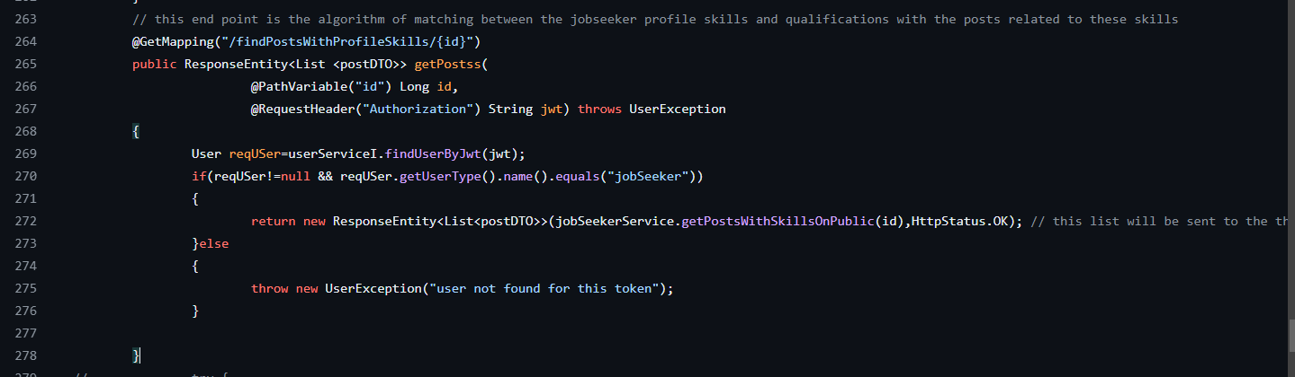
-> 5.4.1.2.3.1: Back-end jobSeeker job matching Algorithm
The main idea of this algorithm is to find the posts that match with jobseeker profile skills and qualifications:
The End Point @GetMapping("/findPostsWithProfileSkills/{id}") : This annotation maps HTTP GET requests to the specified URI ("/findPostsWithProfileSkills/{id}") to this method. It expects an ID as a path variable. (
Logic :
It first attempts to find the user associated with the provided JWT token using userServiceI.findUserByJwt(jwt).
If the user is found and is of type "jobSeeker", it returns a ResponseEntity containing a list of posts with skills on public. .
This end point returns a sorted List of posts from the highest match to the lowest match.

Slide 48
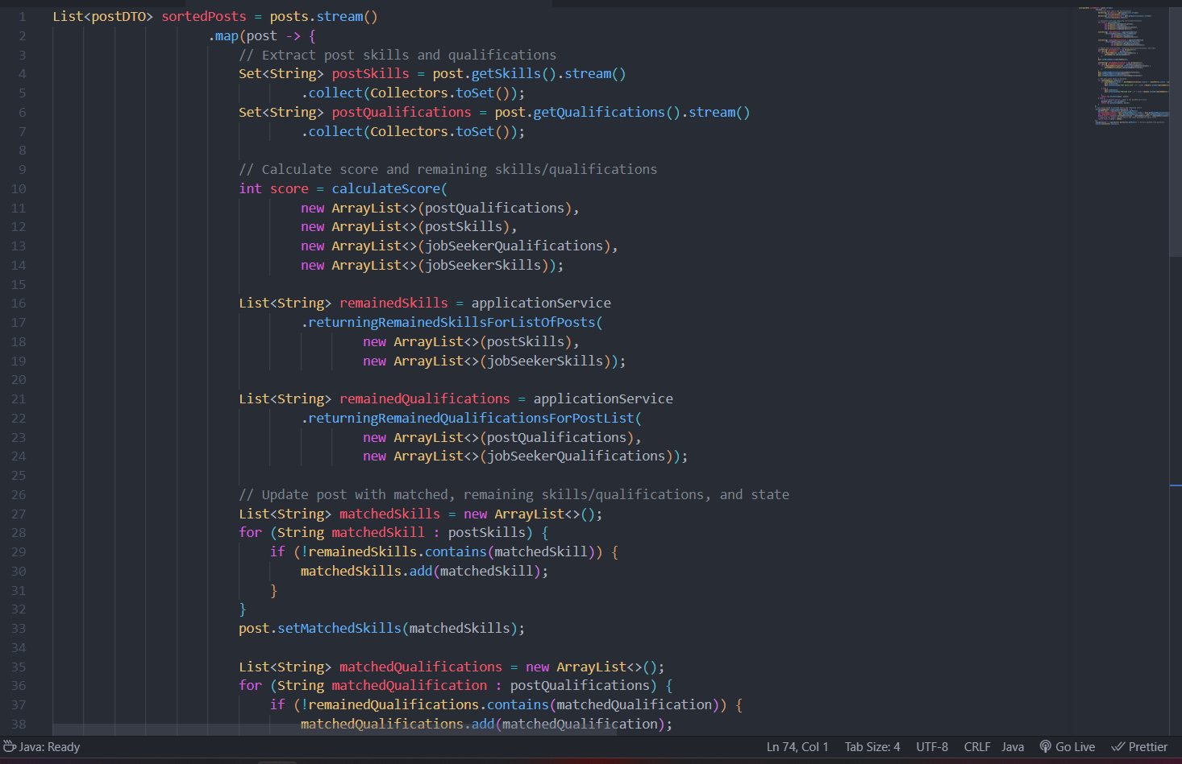
-> 5.4.1.2.3.1: Back-end jobSeeker job matching Algorithm Cont.
This Algorithm Link-> getPostsWithSkillsOnPublic(Long jobSeekerId) :
The main function for this algorithm :
Fetching Job Seeker and Their Skills :
It starts by fetching a job seeker entity by ID using the findById method.
If the job seeker is found, it proceeds to retrieve their skills and qualifications using services jobSeekerSkillServiceI .
Processing posts :
It then proceeds to fetch posts that match the skills of the job seeker. This is done by iterating through each skill of the job seeker and retrieving posts with titles matching those skills.
Additionally, it filters these posts to only include those that the job seeker can apply for, presumably based on some criteria.
Calculating scores and filtering :
For each post, it calculates a score based on the match between the post's required skills/qualifications and the job seeker’s skills/qualifications. The method {calculateScore} is responsible for this.
It then categorizes posts into matched and unmatched based on the calculated score and sets their states accordingly.
Sorting posts :
The posts are sorted based on the number of matched skills and qualifications. Posts with more matches and less remaining skills are prioritized.
Sort posts based on the ratio of matched skills to total skills. ( matchedSkillsCount / (matchedSkillsCount + remainedSkillsCount).
The sorting logic utilizes a comparator to ensure posts with higher matching scores appear first.
Handling Dublicates :
It ensures that duplicate posts are removed, presumably to avoid showing the same post multiple times if it matches multiple skills of the job seeker.
Returning Results:
Finally, it returns a list of unique posts with their respective scores and match statuses (including the percentage of match ).

Slide 49
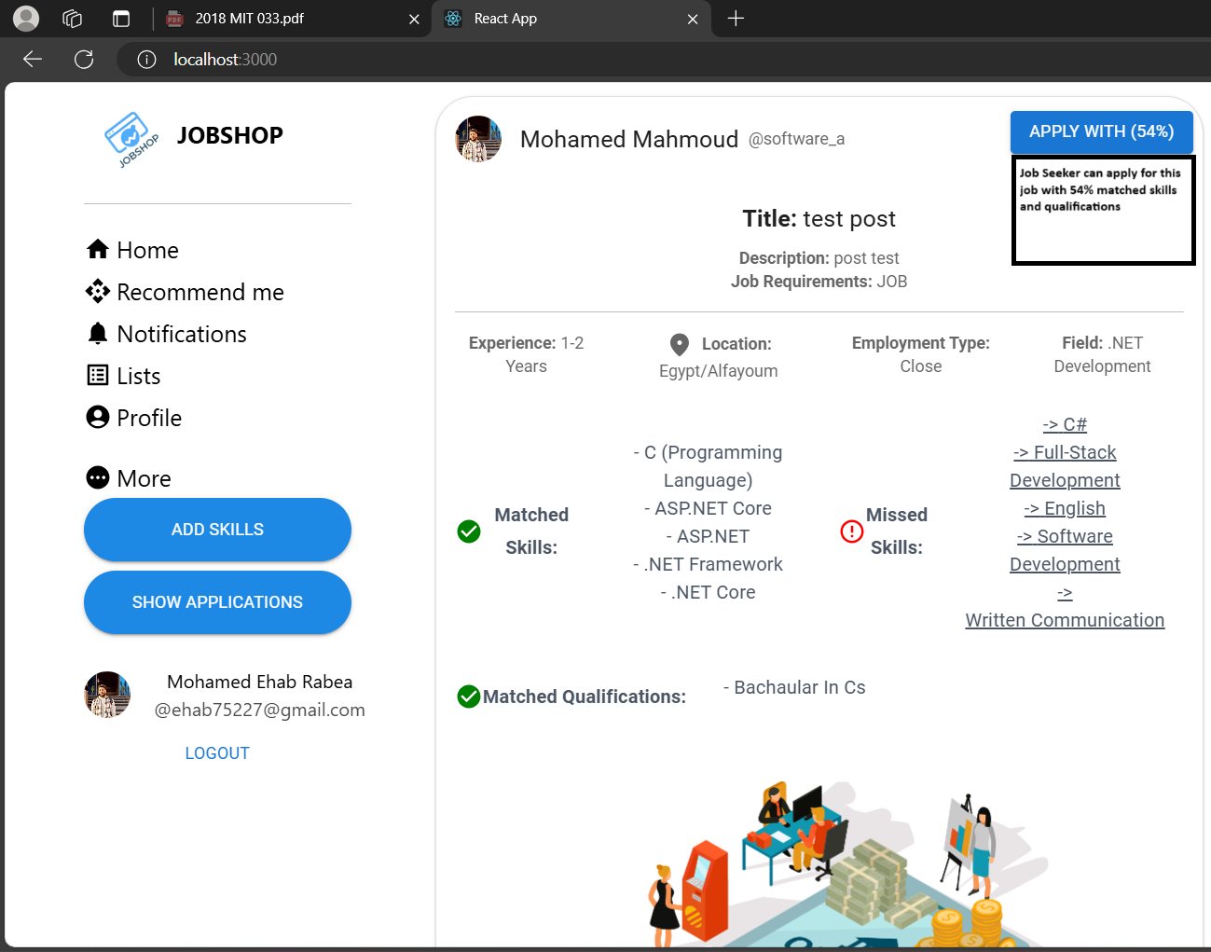
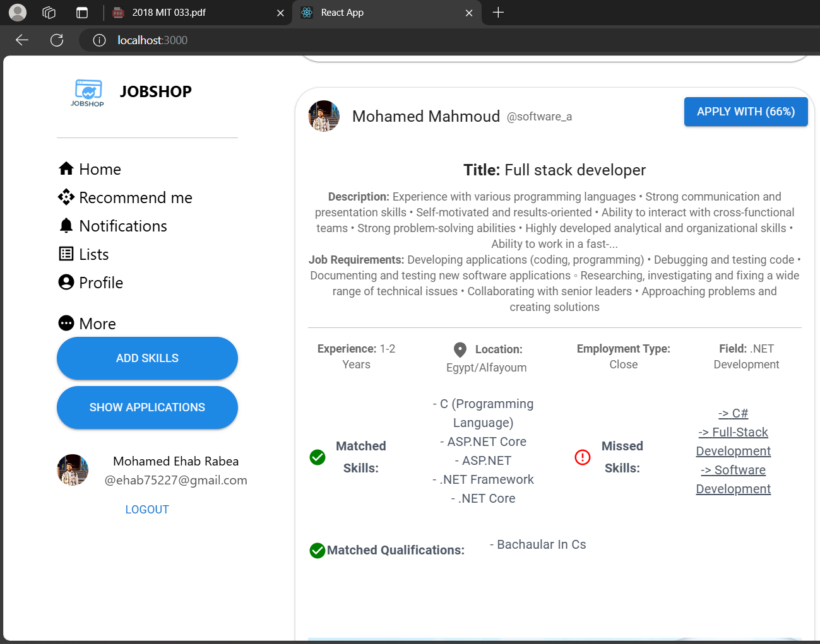
-> 5.4.1.2.3.1: Front-end jobSeeker job matching Algorithm Cont.
Here the user skills matched the two posts put with different percentage , for the first post with 66 % an for the second post with 54%

Slide 50
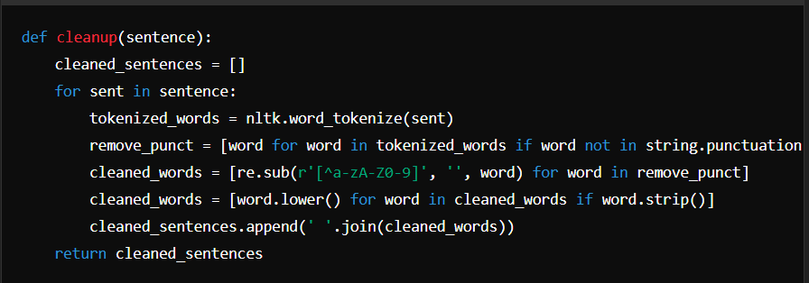
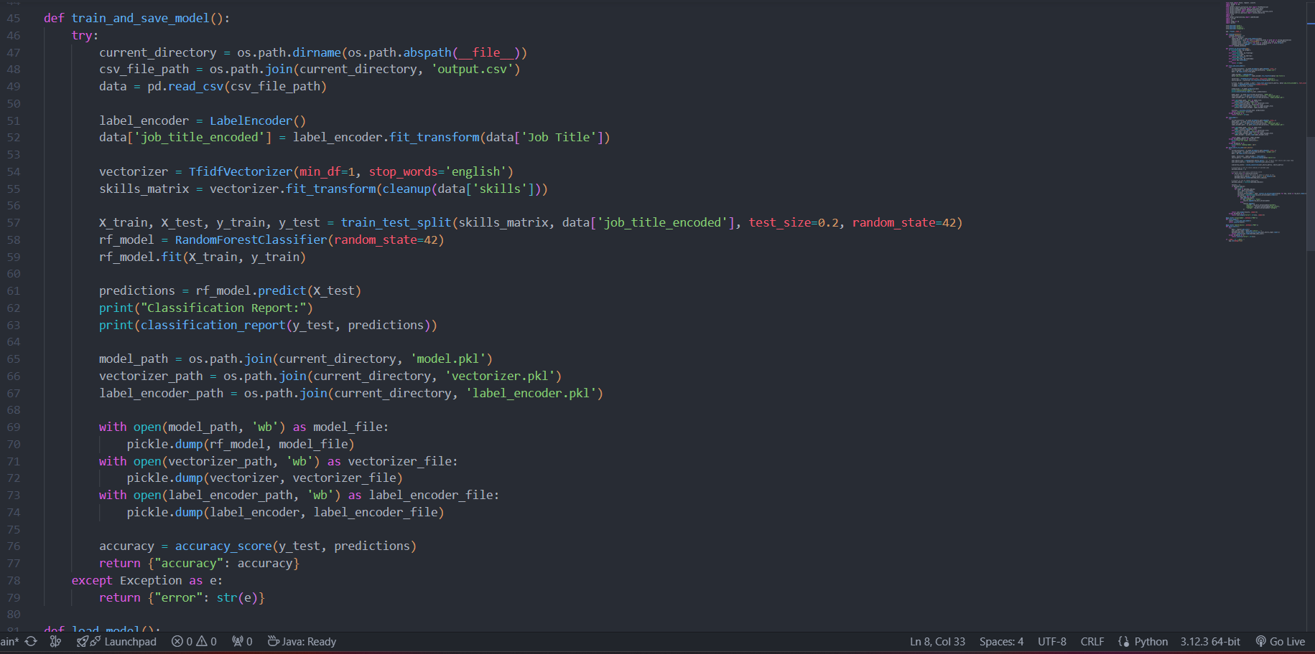
-> 5.4.1.2.3.2: The Ai model For skills matching .
This code is designed to help match job seekers' skills with job postings using machine learning. The main steps involve:
Data Preparation: Cleaning and processing text data.
Model Training: Using a Random Forest classifier to learn from job postings and skills.
Model Deployment: Saving and loading the model for future use.
Skill Matching: Using cosine similarity to find relevant jobs based on user-provided skills.
API Integration: Exposing the functionality via Flask API endpoints
Trains a Random Forest classifier on the job skills data :
The Cleanup function :
This function takes a list of sentences, tokenizes them, removes punctuation, converts them to lowercase, and then joins them back into cleaned sentences.
This is essential for preparing the text data before feeding it into a machine learning model.
Training and Saving the Model :
This function trains a Random Forest classifier on the job skills data. It:
Reads the data from a CSV file.
Encodes job titles into numerical labels.
Transforms the skills into TF-IDF features.
Splits the data into training and testing sets.
Trains the Random Forest model.
Evaluates the model and prints a classification report.
Saves the model, vectorizer, and label encoder to disk.

Slide 51
-> 5.4.1.2.3.2: The Ai model For skills matching cont.
TF-IDF Vectorizer :
TF :
statistical measure used in text mining and information retrieval to evaluate the importance of a word in a document relative to a collection of documents
TF(t,d)= Total number of terms in document d / Number of times term t appears in document d
Inverse Document Frequency (IDF): Measures how important a term is. While computing TF, all terms are considered equally important
IDF(t,D)=log( Number of documents with term tTotal number of documents N​ )

Slide 52
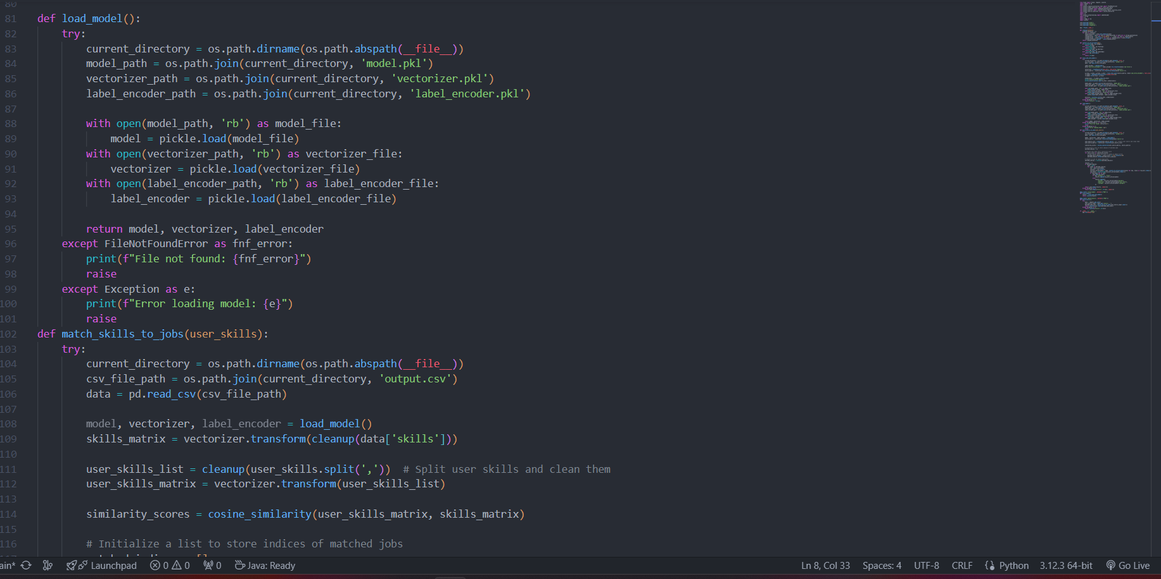
-> 5.4.1.2.3.2: The Ai model For skills matching cont.
Loading the model :
This function loads the previously saved model, vectorizer, and label encoder from disk.
The Dataset Structure :
Dataset contains 4 columns :
postId
Job Title
Skills
Row type

Slide 53
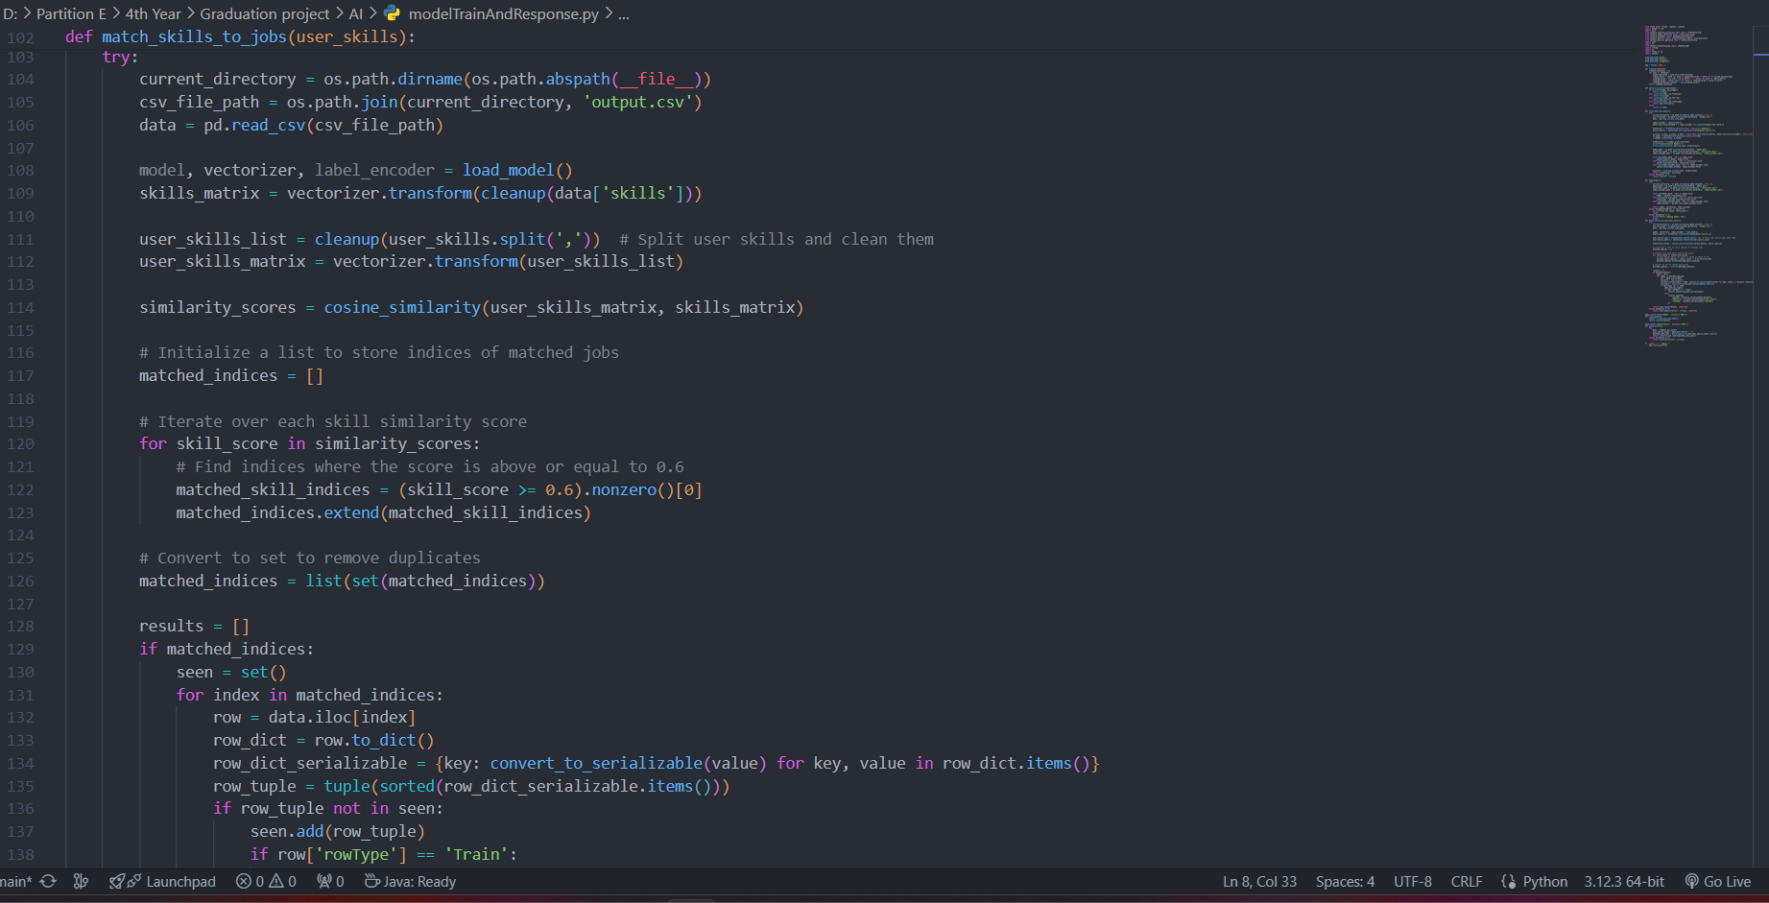
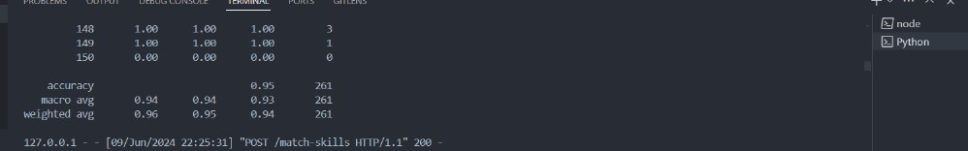
-> 5.4.1.2.3.2: The Ai model For skills matching cont.
Matching Skills to Jobs :
This function matches user-provided skills to job postings:
Loads the job data and the trained model.
Transforms the job and user skills into TF-IDF features.
Computes cosine similarity between user skills and job skills.
Identifies jobs with a similarity score above a threshold (60% in this case).
Returns matched jobs as a JSON object.

Slide 54
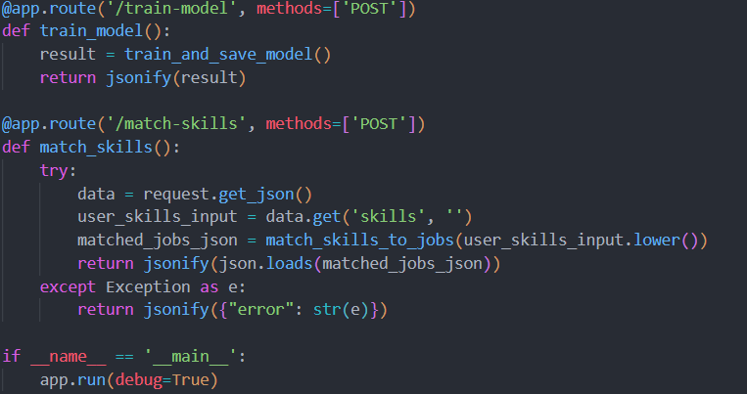
-> 5.4.1.2.3.2: The Ai model For skills matching cont.
Matching Skills to Jobs
These are the two endpoints exposed by the Flask app:
/train-model: Triggers model training and saves the model.
This end point accessed from java back end for running the model to train on the new data and increase the acc.
/match-skills:Takes user skills from the request, matches them to jobs, and returns the matched jobs.

Slide 55
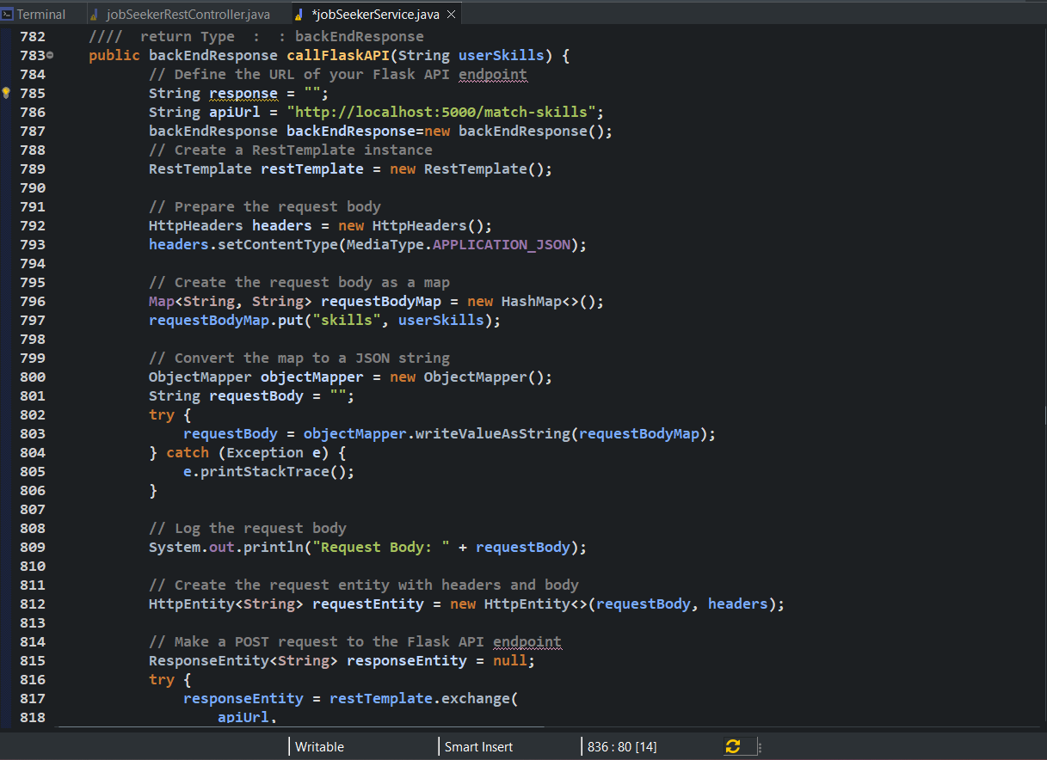
-> 5.4.1.2.3.3: The Connection between the model and the back-end.
Calling Flask API Function:
Send a POST request to a Flask API with the user's skills.
Process the response from the API (Random forest model).
Return the processed response in a structured format.
This function return an object contains the model trained matched posts and the database stored real posts.

Slide 56
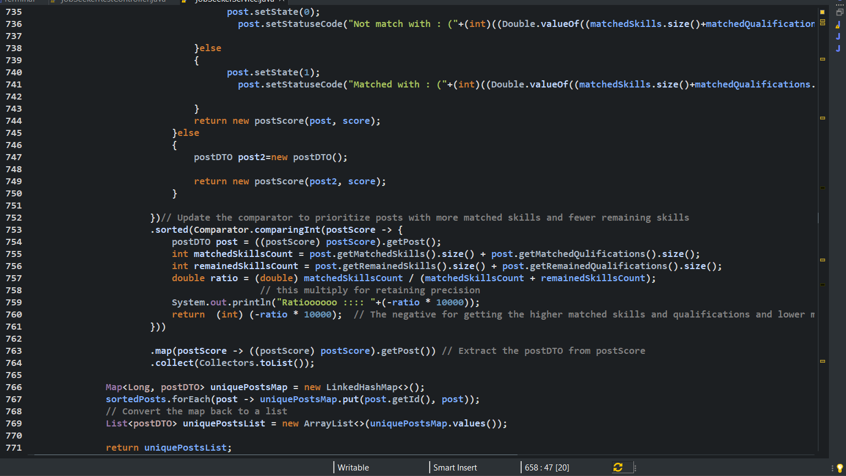
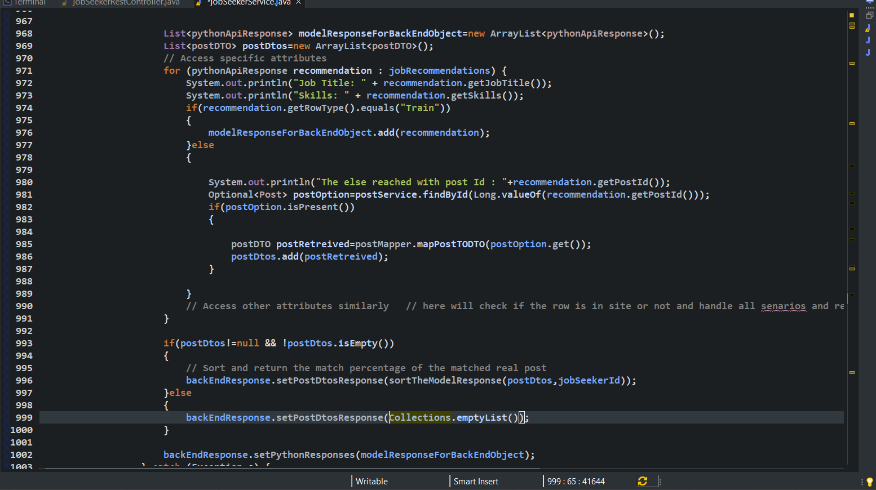
-> 5.4.1.2.3.3: The Connection between the model and the back-end cont.
Calling Flask API Function: Githup Link for this function ->
This iterates through the list of job recommendations. If the rowType is "Train", it adds the recommendation to modelResponseForBackEndObject. Otherwise, it fetches the corresponding post by ID from the postService and maps it to a postDTO object, which is then added to postDtos.
The returned postDtos list will be send to the function sortTheModelResponse(postDtos,jobSeekerId)
This function of sorting the posts includes algorithm of sorting posts from higher match to lower match and also return the percentage of this match with the response .

Slide 57
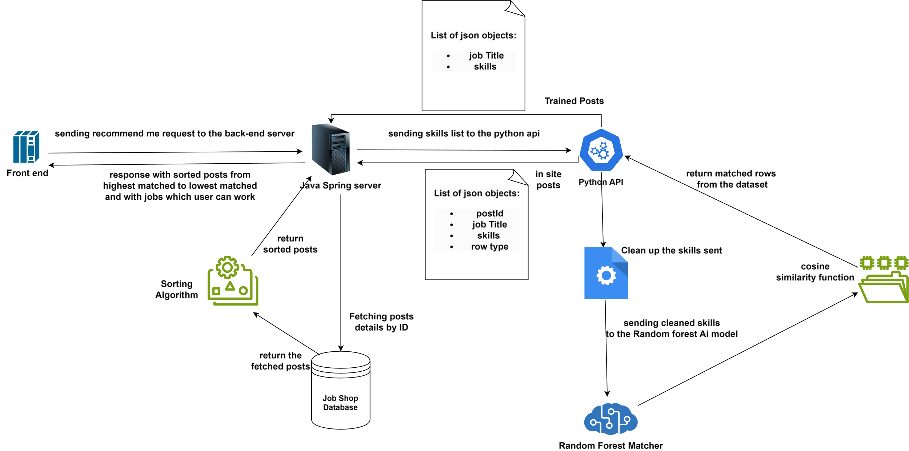
-> The integeration between back-end and ai model:

Slide 58
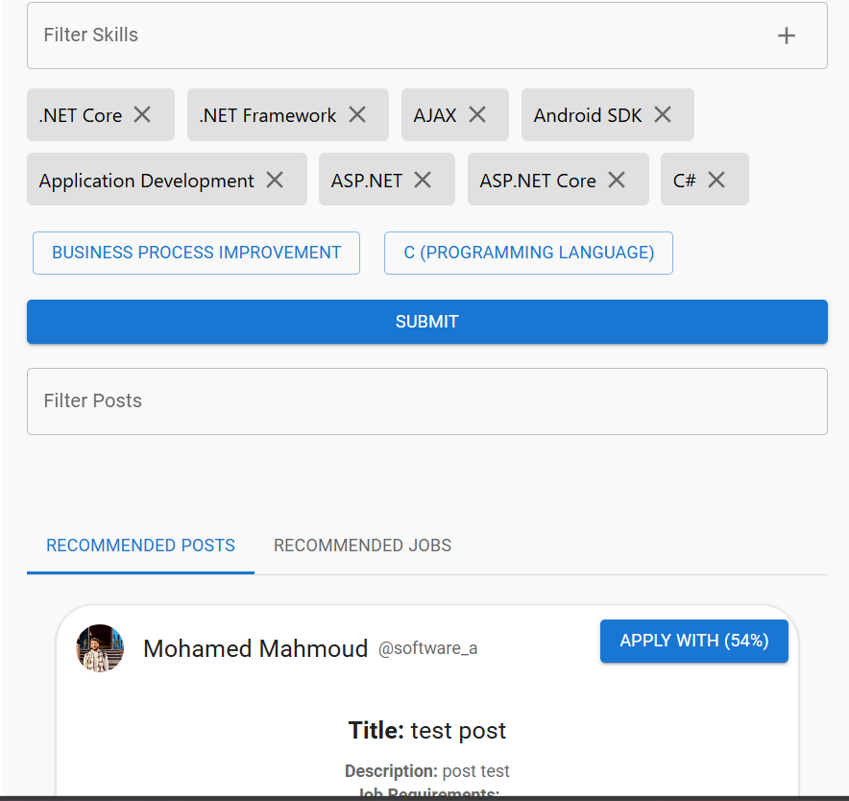
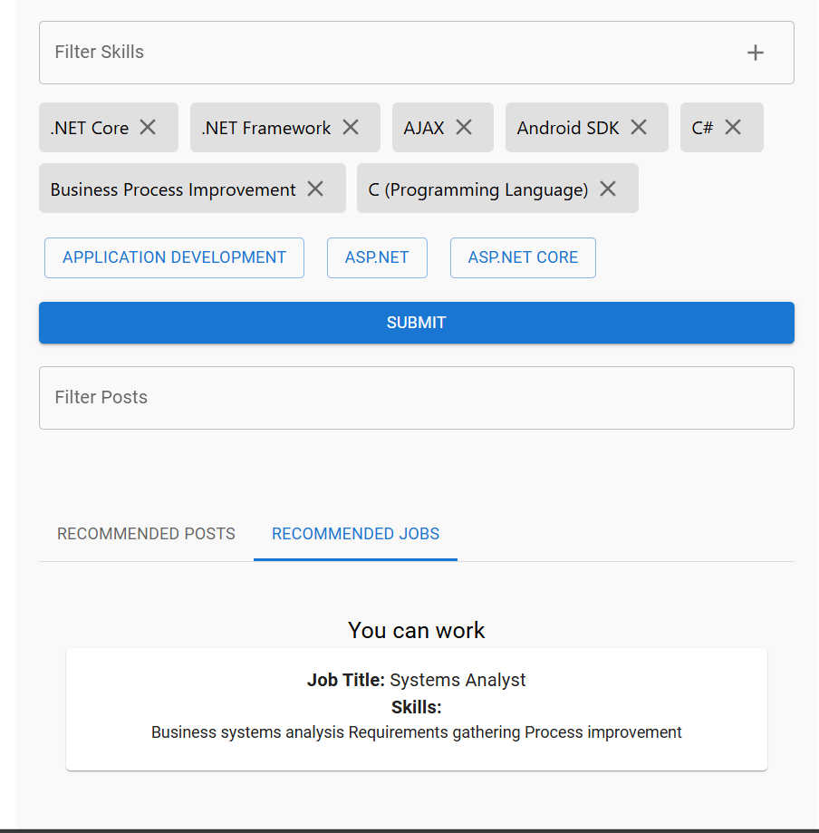
-> 5.4.1.2.3.4: Front-end of ai recommendation model

Slide 59
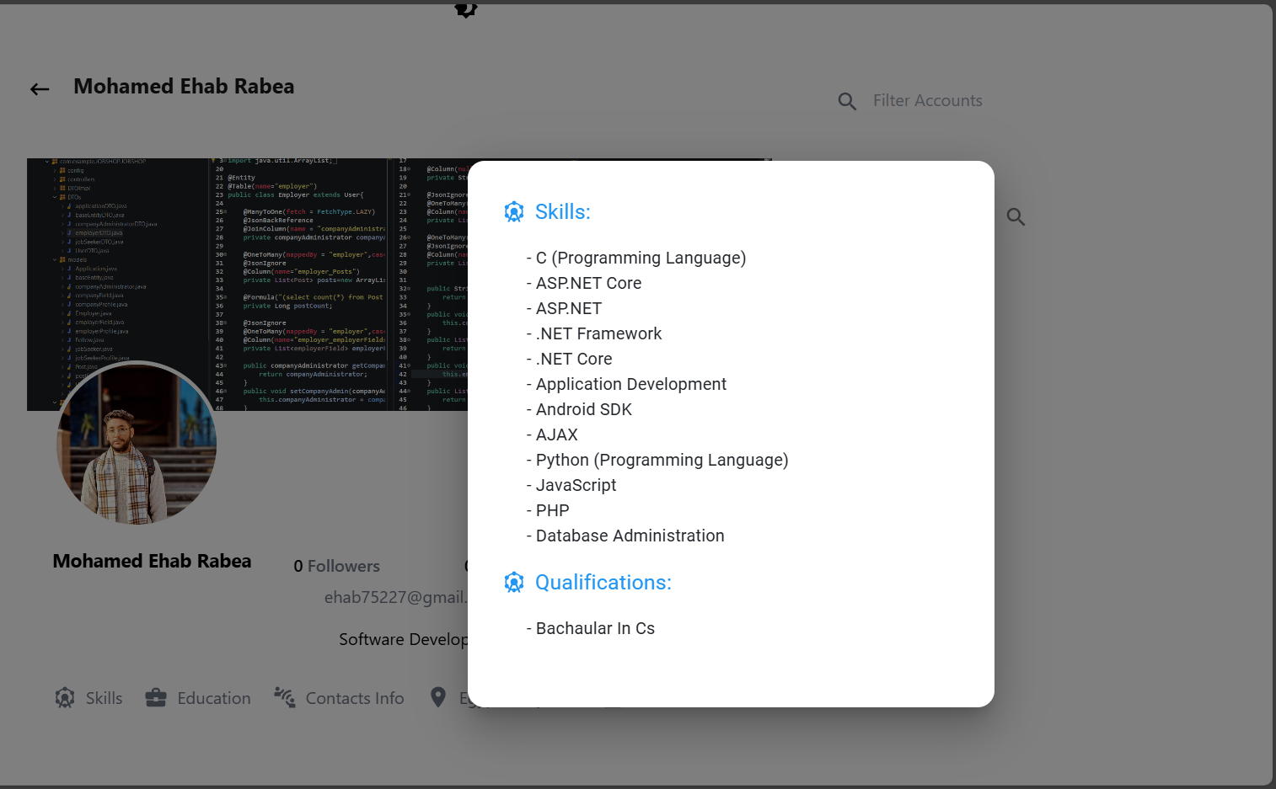
Section: 6.4.1.2.4: Front-end
5.4.1.2.4.1 : jobSeeker Profile Management

Slide 60
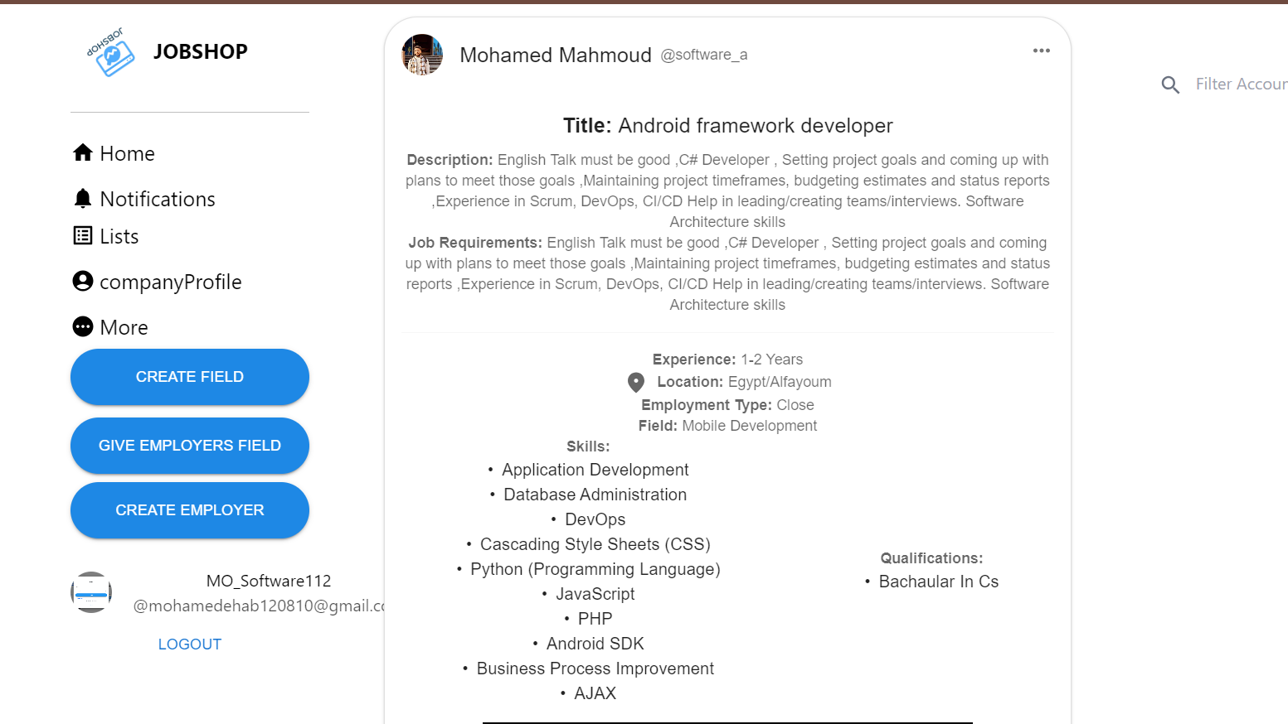
Section: 5.4.1.2.4: Front-end
5.4.1.2.4.2 : Company post details card

Slide 61
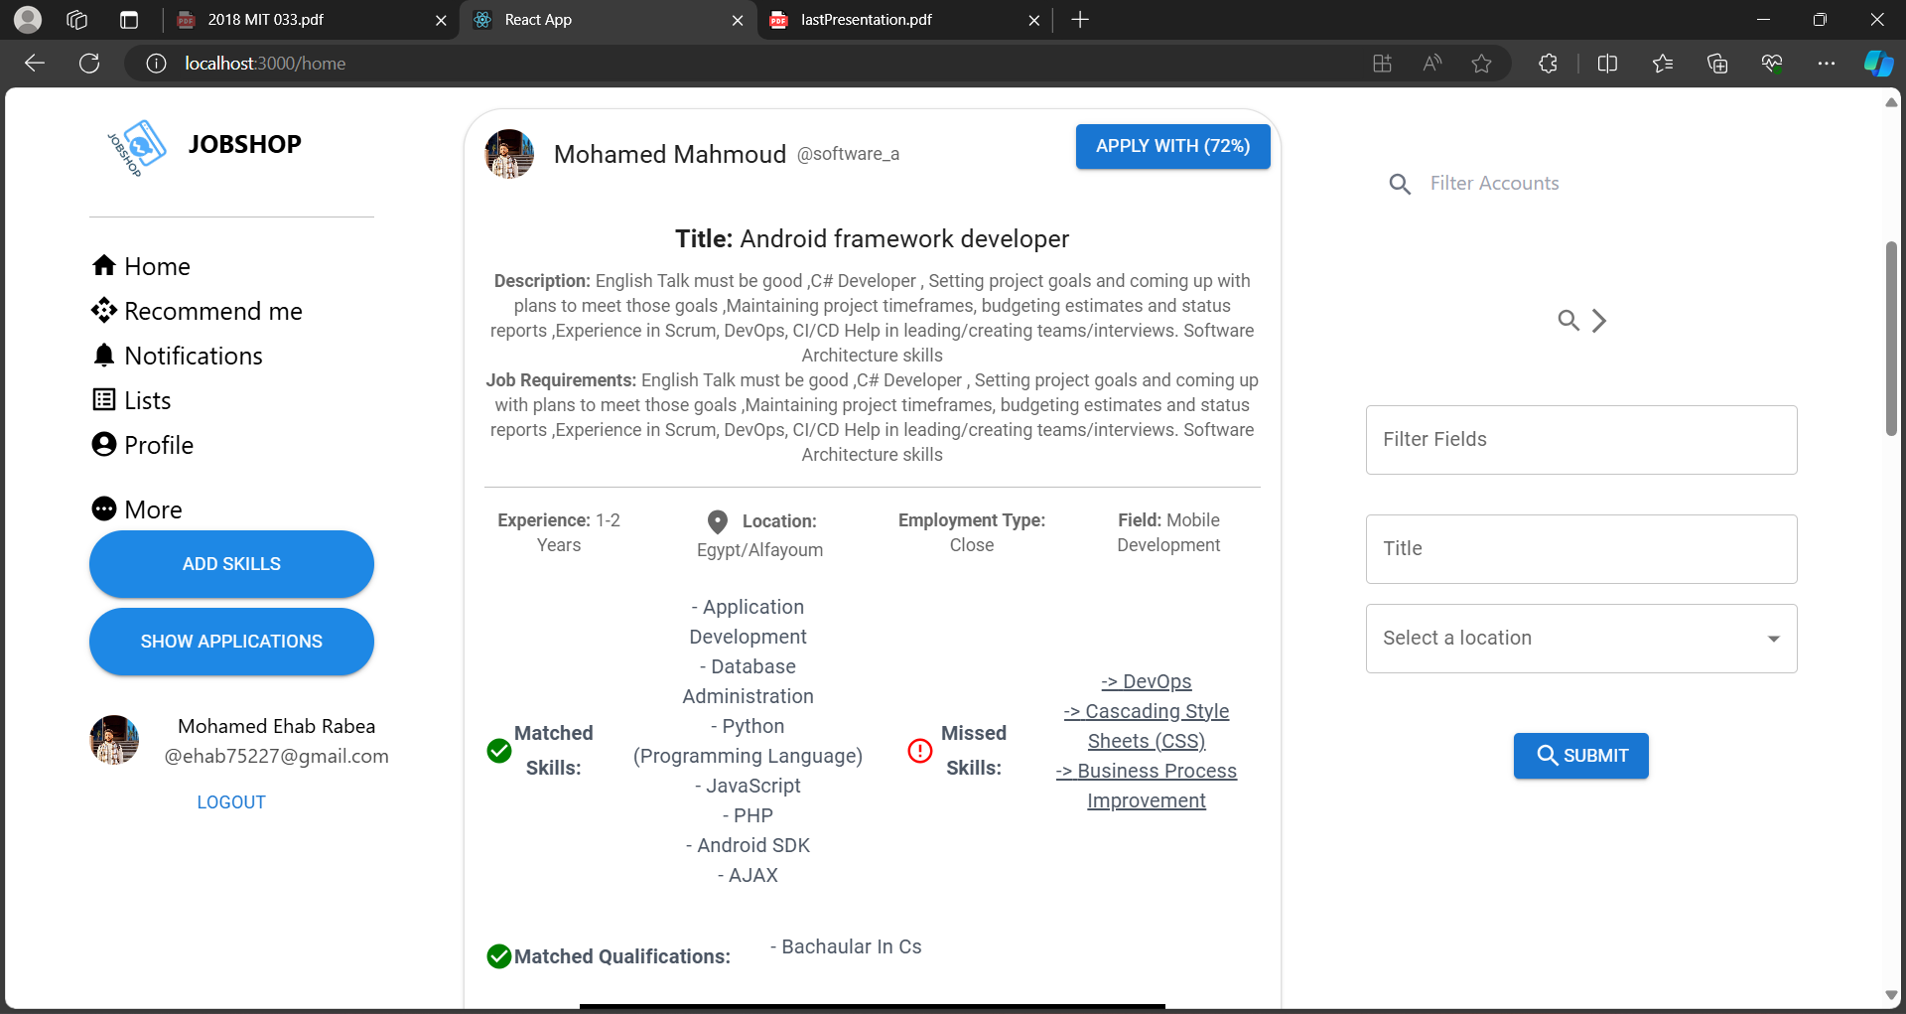
Section: 5.4.1.2.4: Front-end
6.4.1.2.4.3: jobseeker matched post details Card

Slide 62
->Chapter 6 : Testing and Evaluation
The steps involved are:
Build the test plans required in each iteration
Perform integration and system tests
Create test cases to design and implement tests. Test cases define what to test, how to test and create executable test components
Systematically handle and record test results of each test so that the significant defects and be fixed.
6.1 Test Plan :
A software project test plan is a written document that outlines the goals, scope, strategy, and emphasis of a software testing activity. Preparing a test plan is a good approach to think through the steps required to confirm the acceptance of a software product. The finished test plan will assist consumers outside of the test group in comprehending the "why" and "how" of product validation.

Slide 63
6. 2 Requirements Analysis: collecting and assessing customer requirements.
Software Test Plan: defining the scope and goals, developing acceptable testing techniques, developing a software testing strategy, assigning roles and duties, defining resource needs, and establishing start and completion criteria.
Test Environment: establishing the test infrastructure, determining the testing environment and tools, and installing and configuring the product.
Test Metrics: a description of the areas to be measured, as well as the creation and collection of metrics.
Test design and implementation include the creation of test scenarios, test cases, test checklists, test processes, and test scripts, as well as the creation of test applications
Test execution is the static and dynamic performance of testing that is given for the use of human and automatic test cases as needed by STP and STS.
Defect Management (Bug Tracking), documenting testing results, defect description (Problem Reports, Change Requests); defect review and testing results analysis, faults repair, and defect resolution verification
Status reports, weekly reports, milestone reports, and a closing report are all examples of reporting

Slide 64
6.1 Test Planning
STAGE | START DATE | END DATE | DURATION | DATES SPENT
Unit | 7/04/24 | 1/05/24 | 24 day | 28 day
Sub System | 10/05/24 | 25/05/24 | 15 day | 15 day
Integration | 20/05/24 | 30/05/24 | 10 days | 11 day
Acceptance

Slide 65
- 6. 2 Test Cases and Results :
-6.2.1 Test Case for Main Login
Name User Login | Interface Name Main Login | Tested Date
Test Case | Input | Expected Result | Status
Testing Connection to the Server | Server name, user name, password and database name | Display connection confirmation page | OK
Login – Registered User | Username and password | Login confirmation page (Interface Logged User Home) | OK
 | Wrong username or password | Login Error page. Prompt the user for another attempt | OK
Request Password (When forgotten) | Send verification mail including “JWT” token to Gmail | Display confirmation on request | OK
 | Enter username and data that does not match with the user name | Display error page. Prompt for another attempt. | OK
Password Receipt |  | New email from the TTMS Administrator with the new password | OK

Slide 66
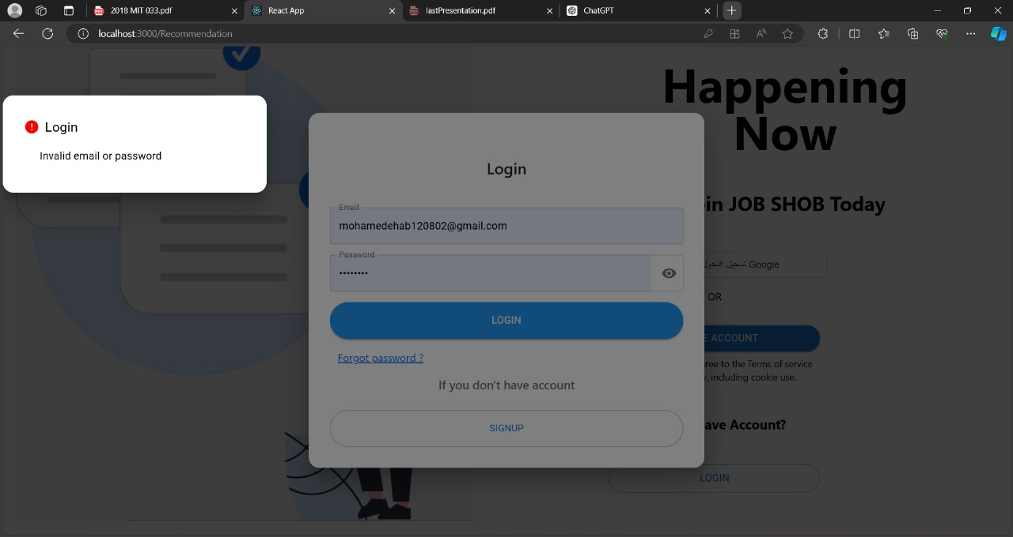
Test Case for Main Login

Slide 67
6.2.2 Test Case for User Registration
Name Test Authentication | Interface Name Main Login | Tested Date
Test Case | Input | Expected Result | Status
Testing Authentication | User name, password in the main login for a user with administrator authentication | Logged administrator’s Home Page | OK
Testing the appropriate services available to the user | Click on each functionality to check the functionality | Availability of appropriate pages for each functional component | OK

Slide 68
- 6.2.3 Test Case for User Registration
Name New User Registration | Interface Name Register New User | Tested Date
Test Case | Input | Expected Result | Status
Request a New User Account | Account details with expected username and contact details | Display request confirmation page | OK
Account Creation |  | If the account created the user enter the home page | OK

Slide 69
- 6.2.4 Test Case for create company Field
Name : New company field Creation. | Interface Name Create Field | Tested Date
Test Case | Input | Expected Result | Status
Testing Create new company field with all data. | Field name , field required skills , Field qualifications | Display newly created field and its skills and qual. | OK
Testing Create new company field with some blank details | With few input missing | Form validation displays errors in relevant fields. System rejects input. | OK

Slide 70
- 6.2.5 Test Case for create company Field
Name : Employer Create. | Interface Name Create Employer | Tested Date
Test Case | Input | Expected Result | Status
Testing Create new Employer with all data. | Employer data : username , email, Password,Gender,country ,contacts,Fields | Display newly Created Employer and his info. | Created
Testing Create new company field with some blank details | With few input missing | Form validation displays errors in relevant fields. System rejects input. | Bad Request

Slide 71
- 6.2.6 Test Case for Give Employer Fields.
Name : Give Employer Fields. | Interface Name Give employer fields | Tested Date
Test Case | Input | Expected Result | Status
Testing Give Employer new fields with all data. | List of Employer fields {employerId ,fieldId}.. | Display message with success. | OK
Testing Give Employer new fields with empty list. | No fields selected | Display error message with failed to give employer empty fieldst. | Bad Request

Slide 72
- 6.2.7 : Test Case for create company Field
Name : Create A Post | Interface Name Job Post | Tested Date
Test Case | Input | Expected Result | Status
Testing Create a post for a specific job with all data . | Post Title , description , location, field name , experience needed , skills , qualifications ,job Requirements ,employmentType , a descriptive picture. | Display successfully post created ,and show the post as the first post in the home page for the employer. | Created
Testing Create a post for a specific job with blank data . | Send a some blank fields | Display error message under each required field blank field | Rejected

Slide 73
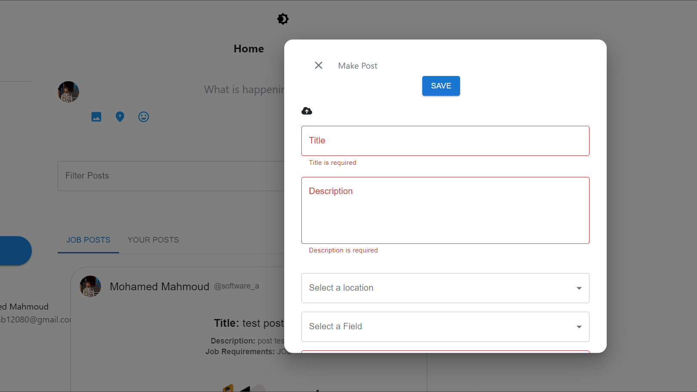
- 6.2.7Test Case for create Post

Slide 74
- 6.2.8: Test Case for Apply for post
Name : Apply on matched post | Interface Name Apply for a post | Tested Date
Test Case | Input | Expected Result | Status
Testing Apply for a job with all data . | Sending list of skills selected directly if these skills at user profile and also the qualifictations, Select the years of experience. | Display a simple report for jobseeker with application results,including the remained skills and qualifictaions. | Created
Testing Apply for a job with no selected experience. | Send a blank field. | Display error message under required field blank field | Rejected

Slide 75
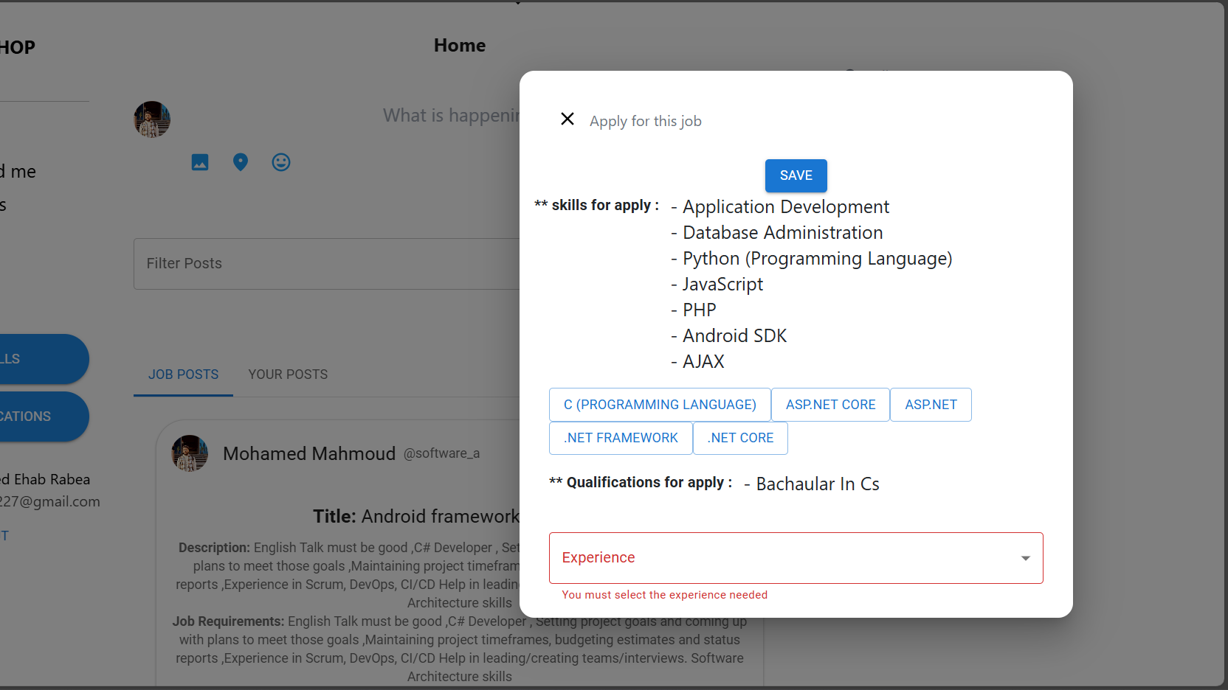
- 6.2.8Test Case for Apply on post.

Slide 76
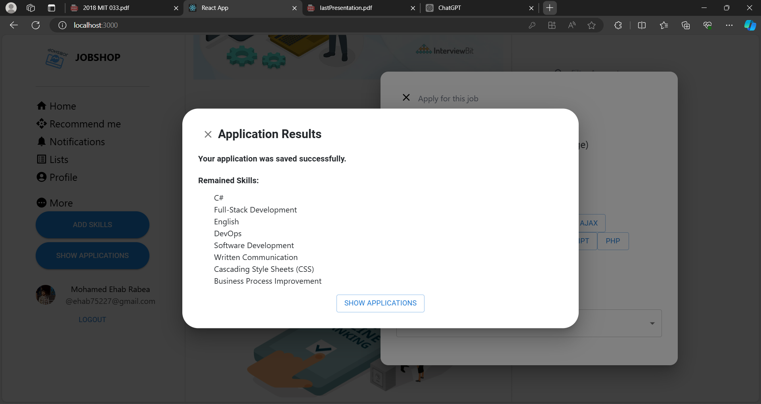
- 6.2.8Test Case for Apply on post.

Slide 77
->Chapter 7 : CONCLUSION
-This chapter wraps up the dissertation with a critical assessment of the system, lessons gained, and recommendations for future research.
8.1 Critical Assessment for Job Recommendation System Recommendation :
a well-designed job recommendation system offers significant benefits to both job seekers and employers, streamlining the job matching process, enhancing the candidate experience, and improving recruitment outcomes
8.2 key points:
1. Enhanced Matching Accuracy: By leveraging advanced algorithms, including machine learning like
TF-IDF job recommendation systems can analyze vast amounts of data to accurately match candidates
with job opportunities that align with their skills
2. Efficiency and Time Savings: For job seekers, these systems reduce the time spent searching for
relevant positions by providing personalized job recommendations. For employers, the automated
filtering and ranking of candidates can significantly cut down the time and effort required to identify
suitable applicants.
3. Personalization: Job recommendation systems can offer highly personalized job suggestions based on
an individual’s profile. This level of customization enhances user
satisfaction and engagement

Slide 78
->Chapter 7 : CONCLUSION
4. Increased Reach and Opportunities: These systems can uncover opportunities that candidates
might not find through traditional search methods, increasing the visibility of lesser-known positions
and helping employers reach a broader pool of potential hires
5. Data-Driven Insights: By analyzing trends and patterns in job searches and applications, these
systems provide valuable insights to both job seekers and employers. Job seekers can understand
in-demand skills and adjust their profiles accordingly, while employers can refine their job postings
and recruitment strategies.
8.3 Future Directions:
1. Enhanced Interactivity: More interactive platforms with chatbots and virtual assistants to guide job
seekers through the application process.
2.Greater Integration with Social Media: Leveraging social networks to gather more comprehensive
candidate profiles and offer more accurate recommendations.
8.4 summary :
job recommendation systems represent a critical tool in the modern recruitment landscape, driving efficiency, personalization, and better outcomes for all stakeholders involved. The continuous advancements in technology promise even greater enhancements in the future, making these systems indispensable in the job search and recruitment processes

Slide 79
->Chapter 7 : CONCLUSION
8.5 Lessons Learnt : During the course of this project considerable number of new concepts and lessons were learnt and they are listed below.
-understanding of Software Engineering was obtained. It was understood that Software Engineering is all about
engineering the artifact from the inception to the release and for this modeling plays an important role.
-Software Project Management - From project proposal through final system implementation, all aspects of a typical
software project were thoroughly covered
-An insight to proper documentation was well covered. The importance of documentation at all stages of the Software
Life Cycle was clearly understood.
-The application of Object Oriented concepts in analysis, design and implementation stages to create more practical,
robust, maintainable and platform independent components were well appreciated.
-Writing working web applications and use of java spring boot , MySQL
- practice with AI and machine learning “by python”
-knowledge about UI/UX and designing interactive UI using HTML CSS JavaScript (React js ).

Slide 80
Video for main functions

